Slide 1



Reverse phase operation for CERN's FCC-ee 400 MHz RF system: Increasing flexibility brings challenges for cavity control
Ivan Karpov and Franck Peauger for FCC SRF WP1 with input from:
Xavier Buffat, Yann Dutheil, Giorgia Favia, Jiquan Guo (JLAB), Mauro Migliorati (INFN), Katsunobu Oide, Luca Sabato, Roxana Soos, Jorg Wenninger, Frank Zimmermann, Mikhail Zobov (INFN)
LLRF 2025, 13.11.2025

Slide 2
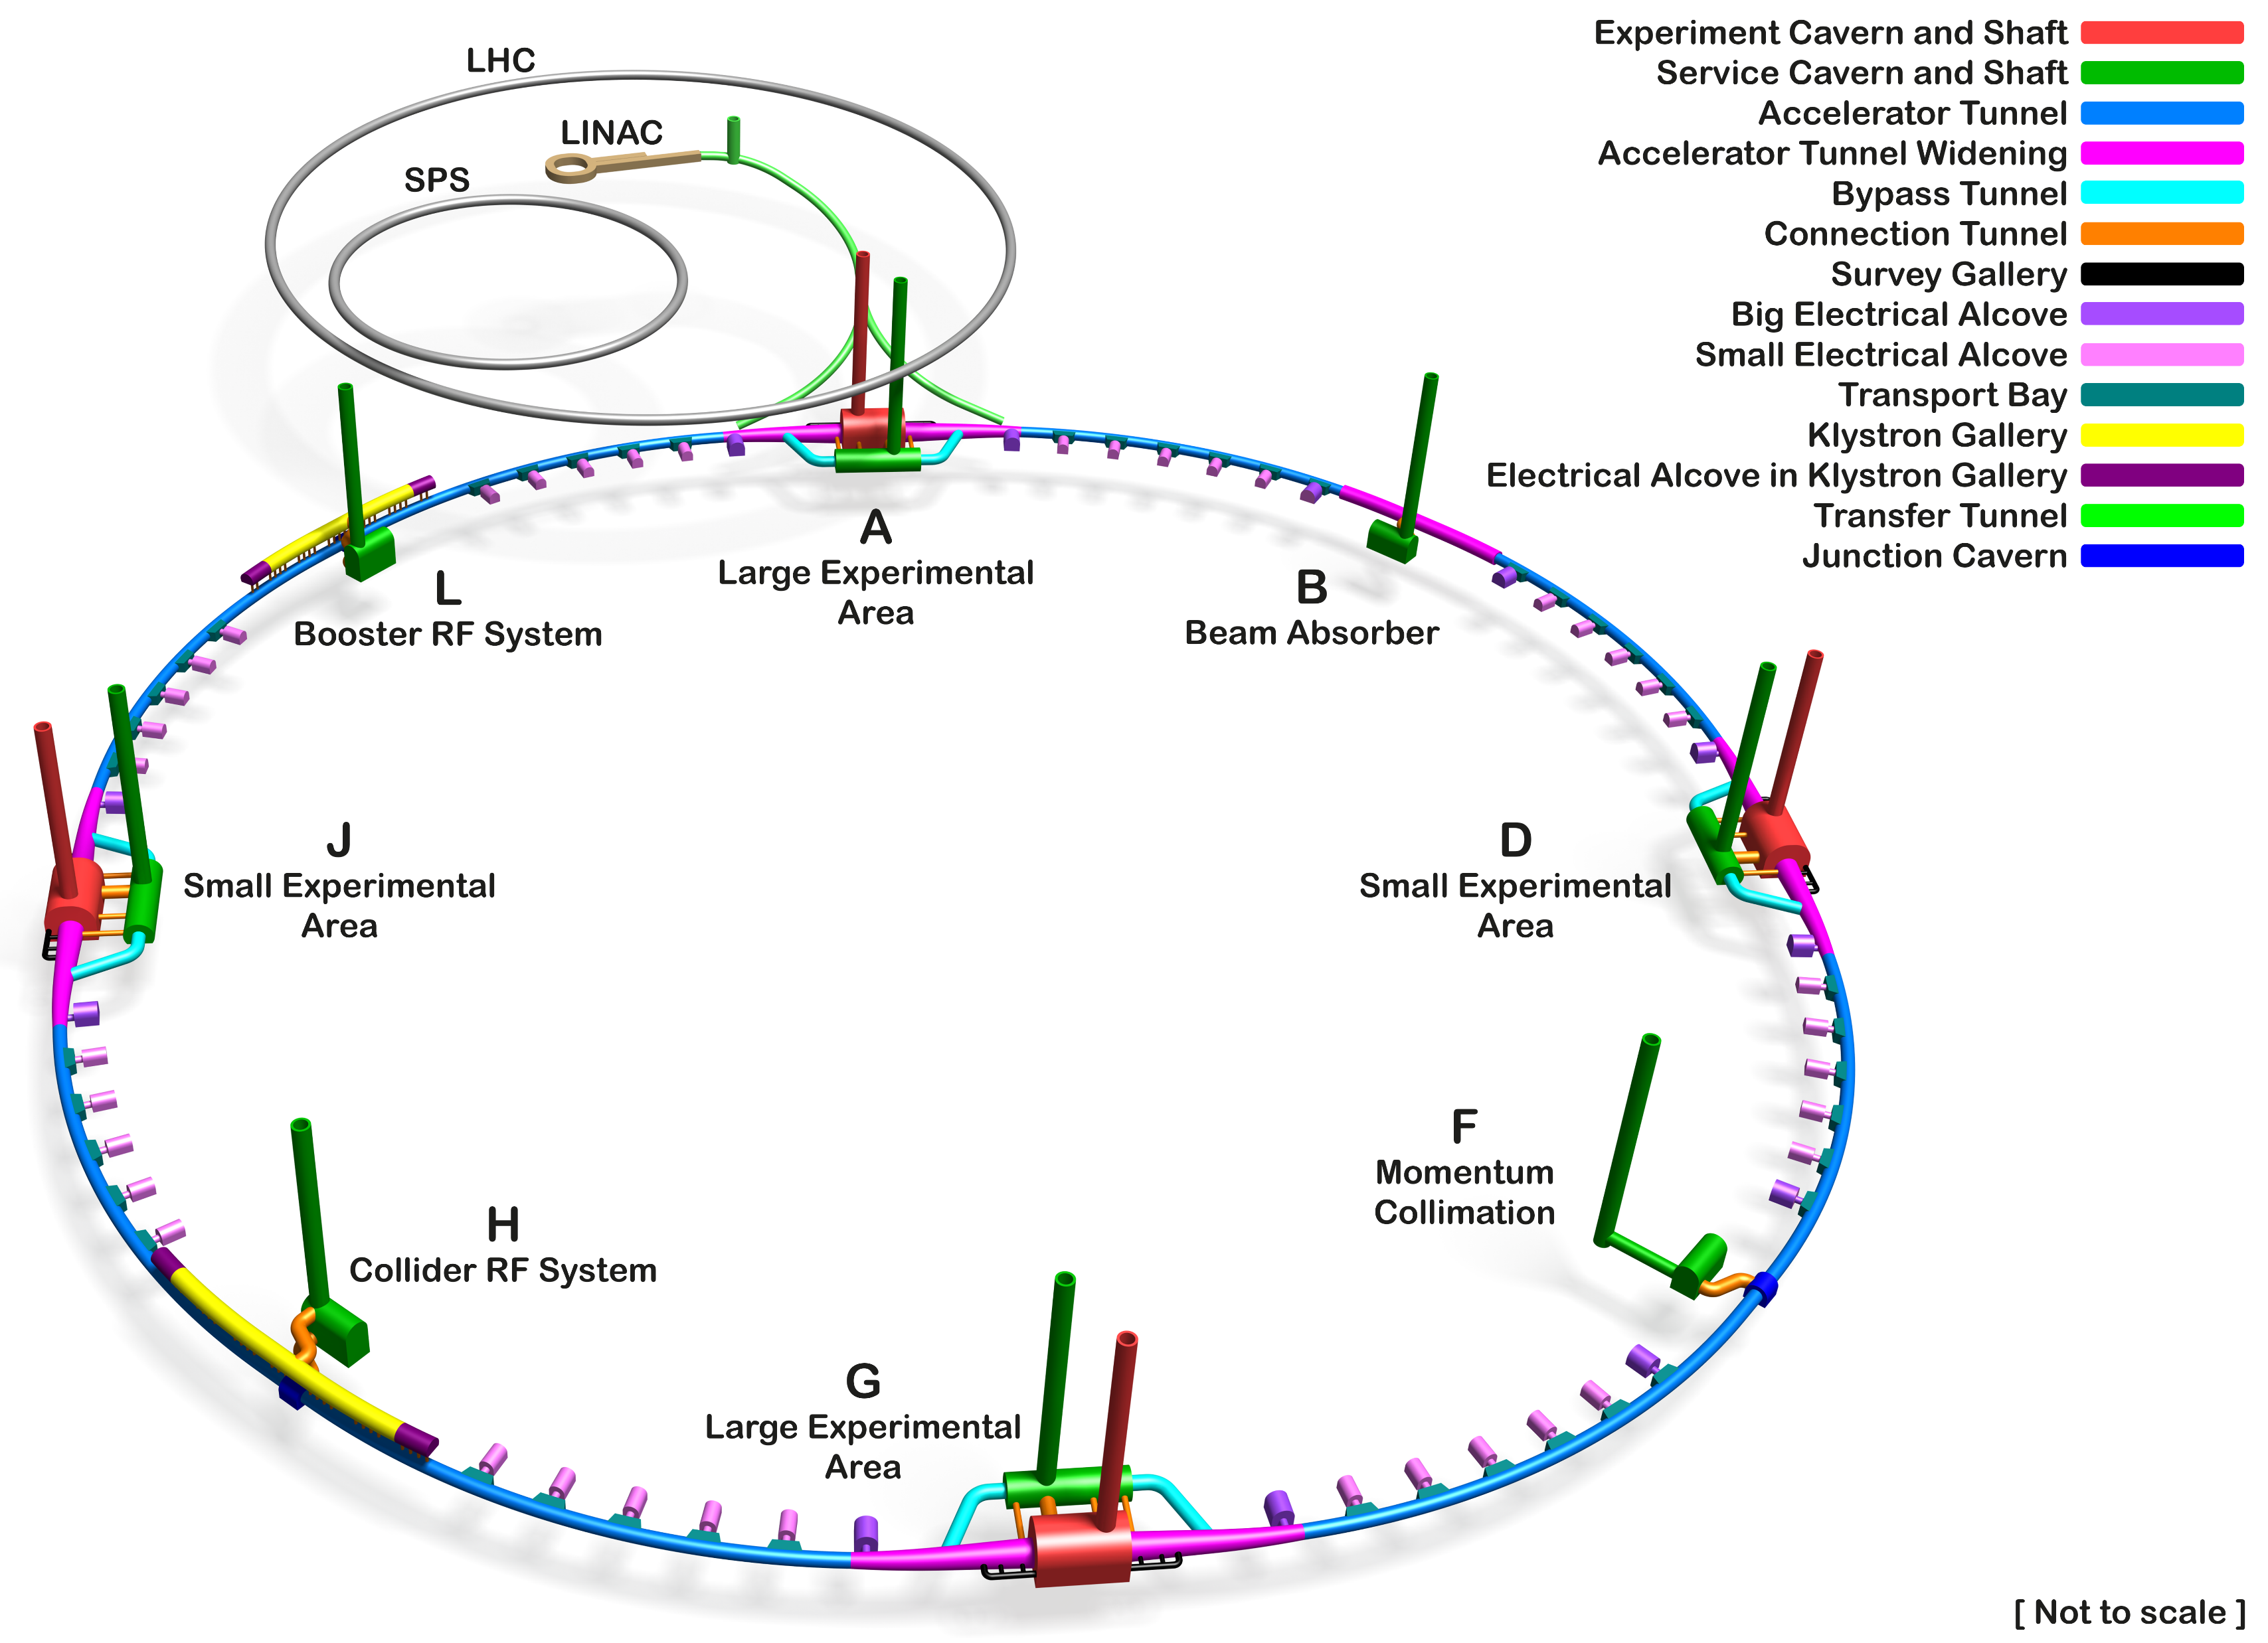
Future Circular e⁺e⁻ collider (FCC-ee)
An e+e- collider as the 1st stage of the integrated FCC program
New 90.7 km tunnel to be later reused for a hadron collider
Double-ring collider (separate beam pipes for electrons and positrons)
Collider runs at constant energy
Regular top-up injection from a full-energy booster synchrotron, located in the same tunnel
SC RF systems in two straight sections
Courtesy A. Navascues Cornago

Slide 3
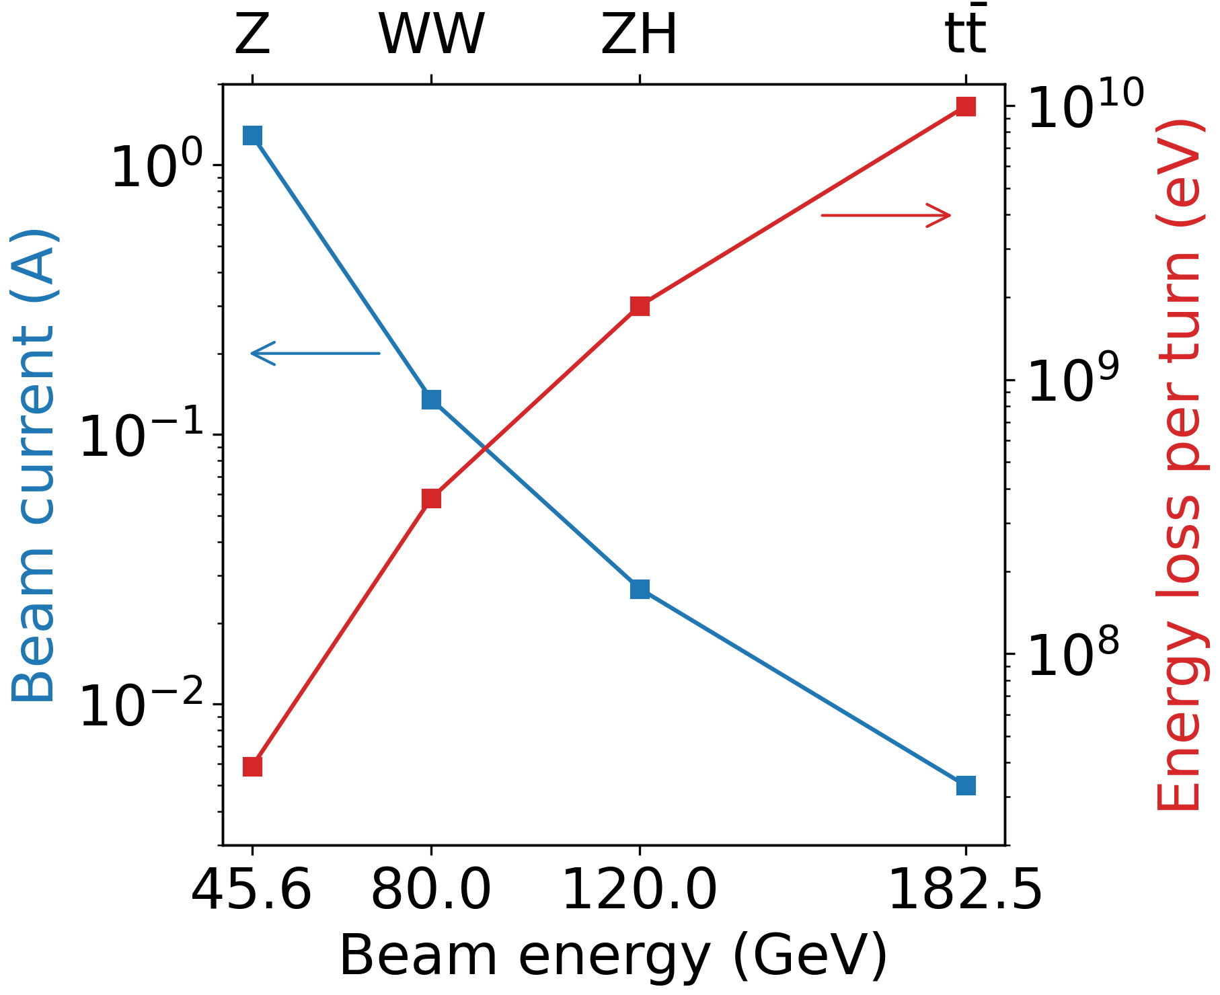
Challenging requirements for FCC-ee RF system
Beam current and energy loss for 50 MW synchrotron radiation (SR) budget
Low energy operating points:
High beam current and weak SR
Low RF voltage
Beam instabilities
Significant power losses due to high-order modes (HOM)
High energy points:
Low beam current and strong SR
High RF voltage to be reached with a small footprint
Instabilities suppressed by SR
Small power losses due to low beam current
A few one- or two-cell cavities at low RF frequency (400 MHz)
Many multi-cell cavities at higher RF frequency (800 MHz)
RF system choice is driven by minimization of hardware modification between operating points

Slide 4
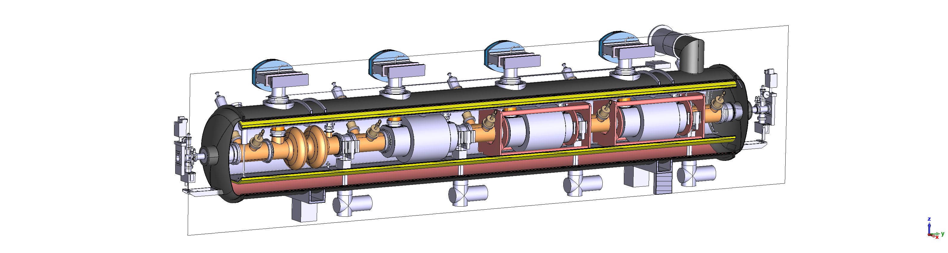
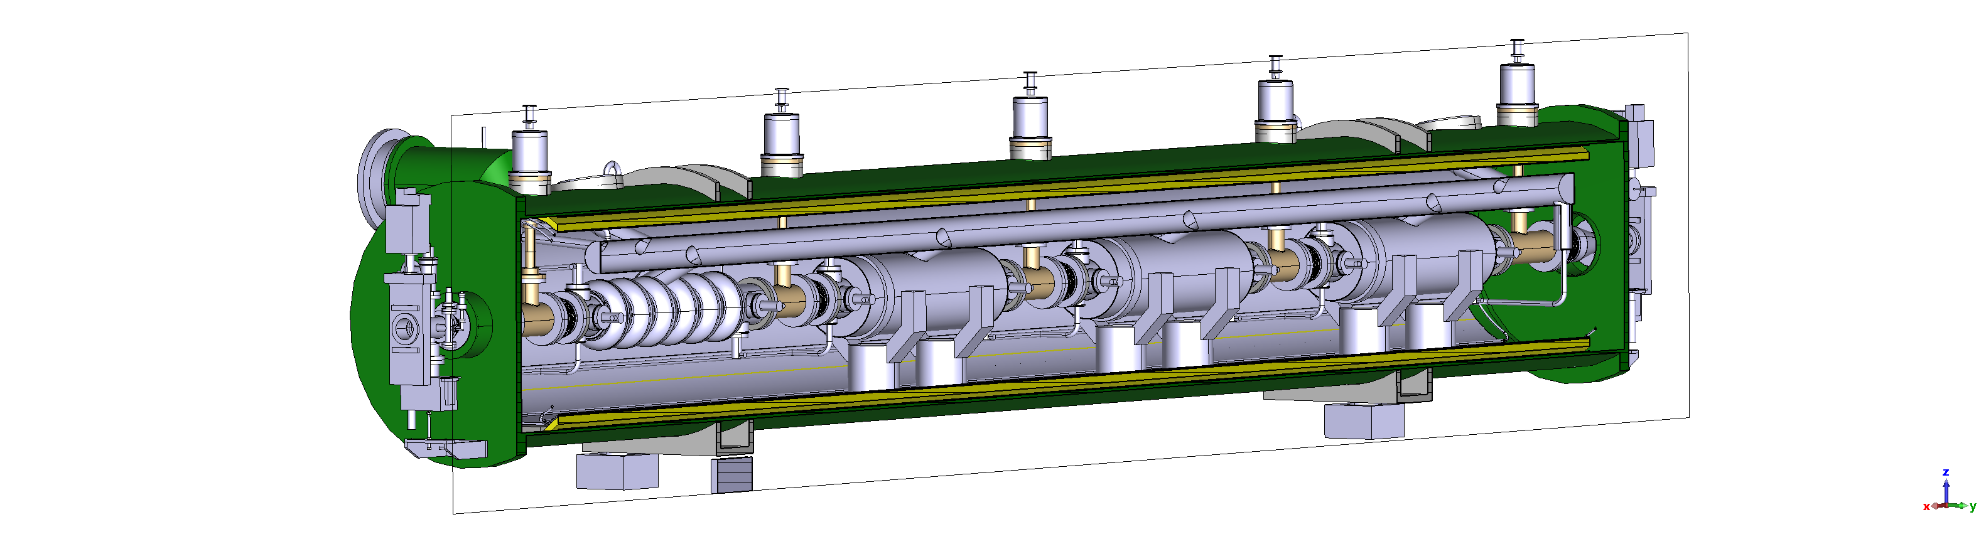

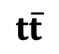

Collider RF system layout
400 MHz 2-cell cryomodule (CM) (FCCACSGA0002)
800 MHz 6-cell CM (FCCACSGA0003)
F. Cottenot, M. Timmins, and V. Parma
$$Z$$
&
$$WW$$
Beam 1
33 400 MHz CMs
33 400 MHz CMs
Beam 2
33 400 MHz CMs
33 400 MHz CMs
$$ZH$$
Common RF for 2 beams
33 400 MHz CMs
102 800 MHz CMs
33 400 MHz CMs
$$t\overline{t}$$

Slide 5
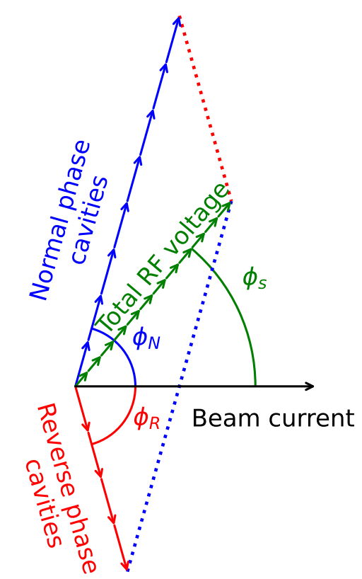
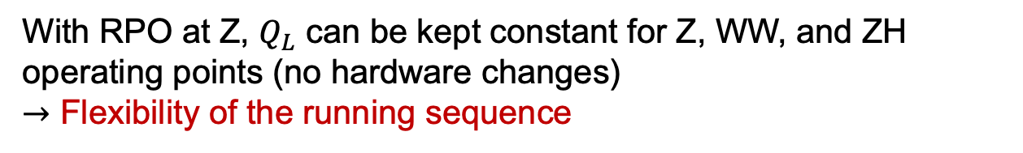
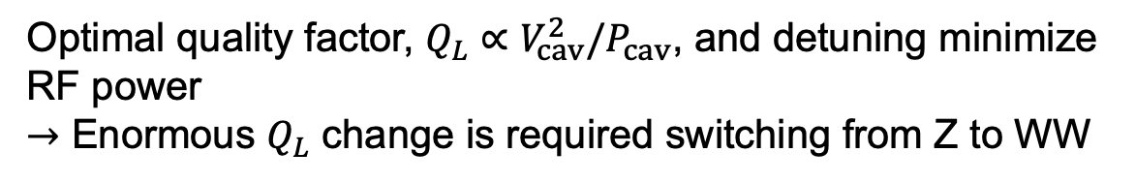
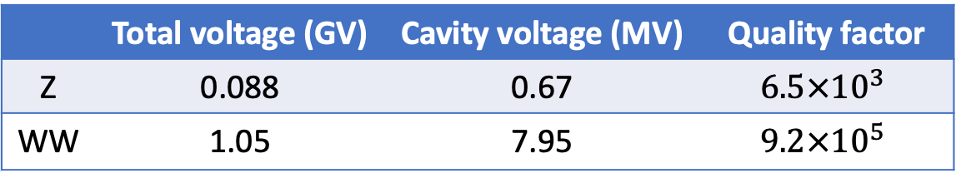
Reverse phase operation
Optimal quality factor, $Q_{L}∝V_{cav}^{2}/P_{cav}$, and detuning minimize RF power
$→$ Enormous $Q_{L}$ change is required switching from Z to WW
A sketch of RPO mode for 12 RF cavities
 | Total voltage (GV) | Cavity voltage (MV) | Quality factor
Z | 0.088 | 0.67 | $$6.5×{10}^{3}$$
WW | 1.05 | 7.95 | $$9.2×{10}^{5}$$
Reverse phase operation (RPO) mode:
Proposed to increasing RF cavity voltage (Y. Morita et al., SRF, 2009)
Experimentally verified with high beam loading in KEKB (Y. Morita et al., IPAC, 2010)
Baseline solution for EIC ESR (e.g., J. Guo et al., IPAC, 2022)
With RPO at Z, $Q_{L}$ can be kept constant for Z, WW, and ZH operating points (no hardware changes)
$→$ Flexibility of the running sequence

Slide 6
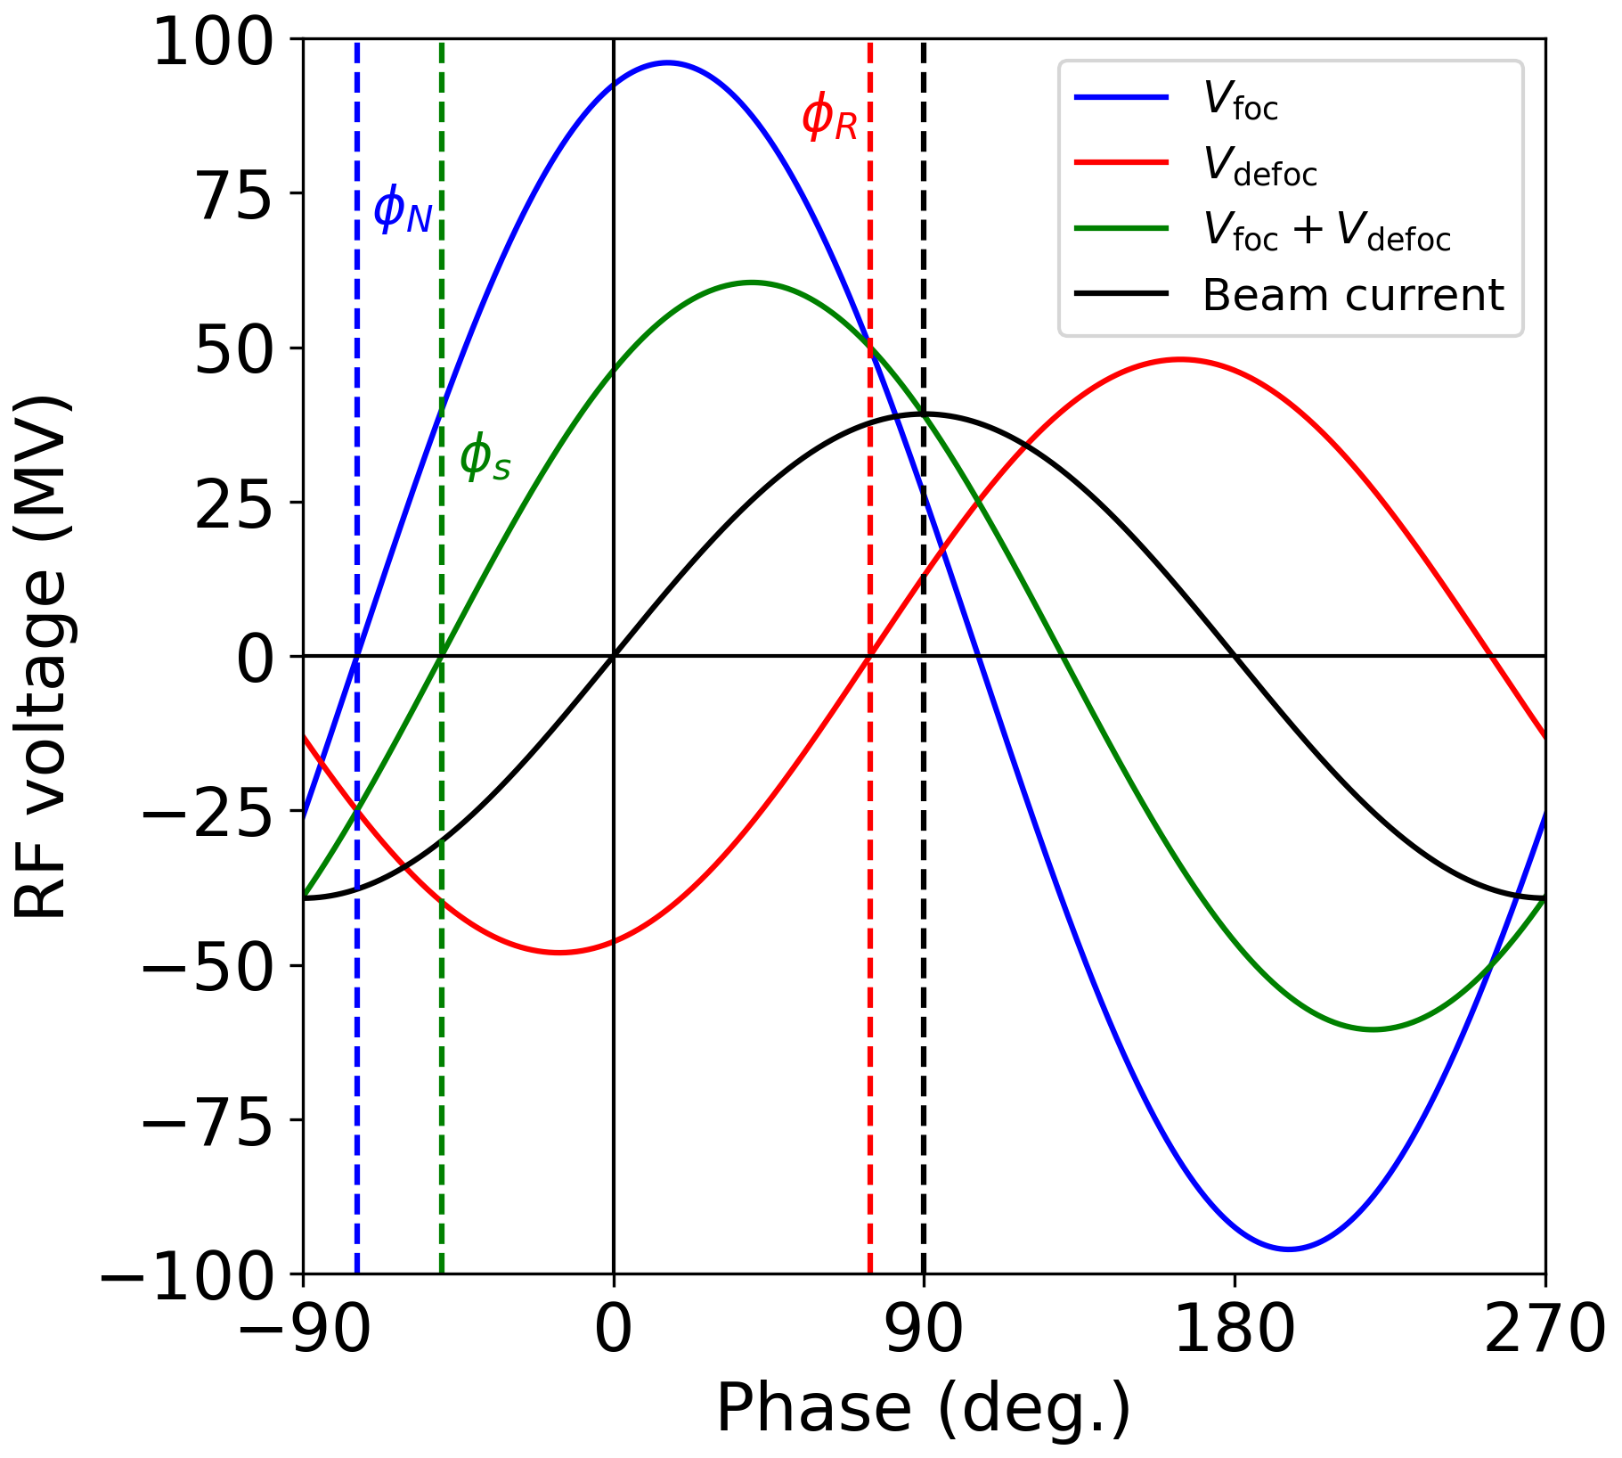
Reverse phase operation
Optimal quality factor, $Q_{L}∝V_{cav}^{2}/P_{cav}$, and detuning minimize RF power
$→$ Enormous $Q_{L}$ change is required switching from Z to WW
A sketch of RPO mode for 12 RF cavities
 | Total voltage (GV) | Cavity voltage (MV) | Quality factor
Z | 0.088 | 0.67 | $$6.5×{10}^{3}$$
WW | 1.05 | 7.95 | $$9.2×{10}^{5}$$
Reverse phase operation (RPO) mode:
Proposed to increasing RF cavity voltage (Y. Morita et al., SRF, 2009)
Experimentally verified with high beam loading in KEKB (Y. Morita et al., IPAC, 2010)
Baseline solution for EIC ESR (e.g., J. Guo et al., IPAC, 2022)
With RPO at Z, $Q_{L}$ can be kept constant for Z, WW, and ZH operating points (no hardware changes)
$→$ Flexibility of the running sequence
Focusing cavities
Defocusing cavities

Slide 7
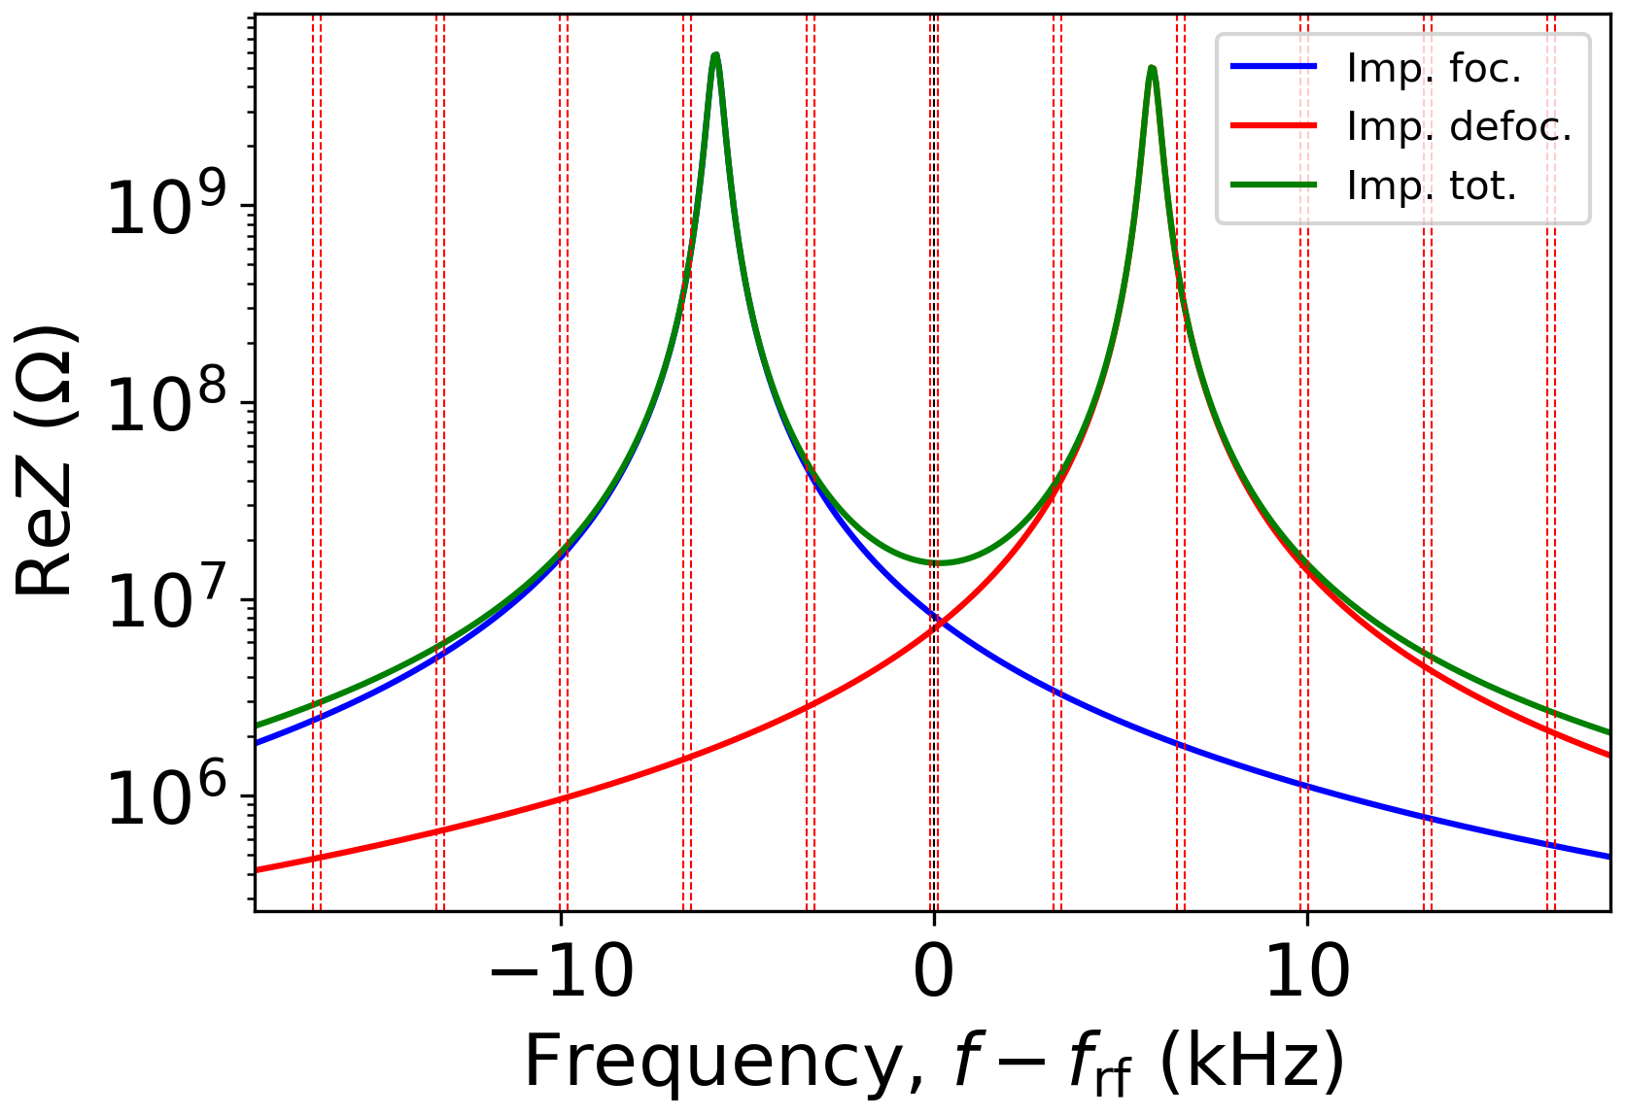
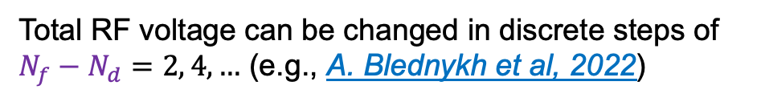
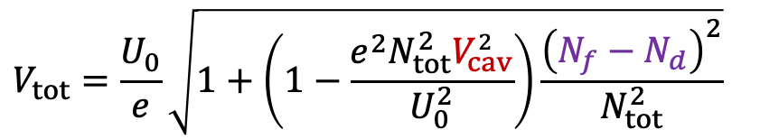
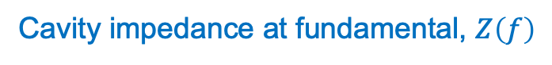
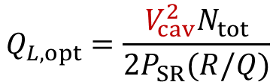
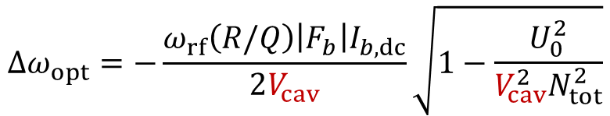
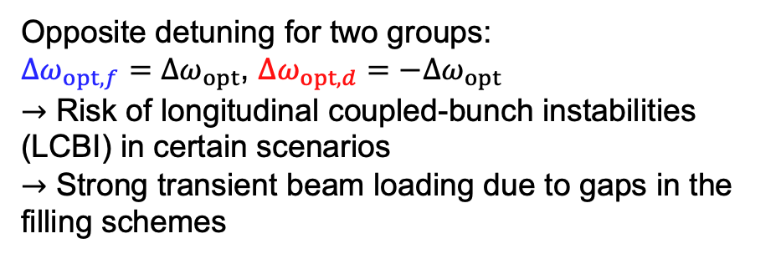
Static beam loading compensation with RPO
To minimize RF power requirements optimal quality factor and optimal detuning must be used
$$Q_{L,opt}=\frac{V_{cav}^{2}N_{tot}}{2P_{SR}(R/Q)}$$
$$Δω_{opt}=−\frac{ω_{rf}\left(R/Q\right){\left|F_{b}\right|I}_{b,dc}}{2V_{cav}}\sqrt{1−\frac{U_{0}^{2}}{V_{cav}^{2}N_{tot}^{2}}}$$
Total RF voltage can be changed in discrete steps of $N_{f}−N_{d}$ $=2, 4,…$ (e.g., A. Blednykh et al, 2022)
Cavity impedance at fundamental, $Z\left(f\right)$
$$V_{tot}=\frac{U_{0}}{e}\sqrt{1+\left(1−\frac{e^{2}{N_{tot}^{2}V}_{cav}^{2}}{U_{0}^{2}}\right)\frac{{\left(N_{f}−N_{d}\right)}^{2}}{N_{tot}^{2}}}$$
Opposite detuning for two groups:
$Δω_{opt,f}=Δω_{opt}$, $Δω_{opt,d}=−Δω_{opt}$
$→$ Risk of longitudinal coupled-bunch instabilities (LCBI) in certain scenarios
$→$ Strong transient beam loading due to gaps in the filling schemes

Slide 8
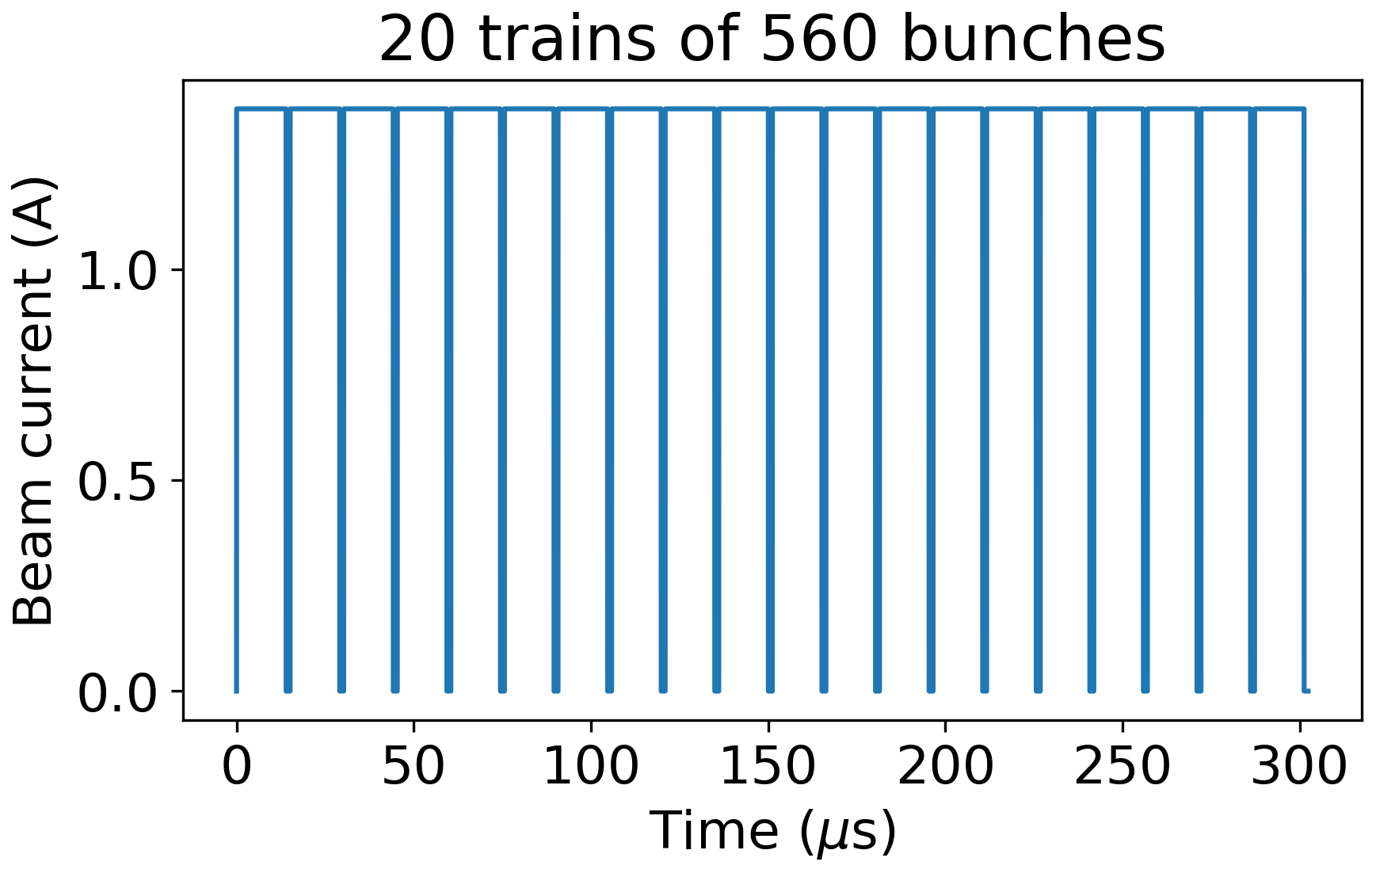
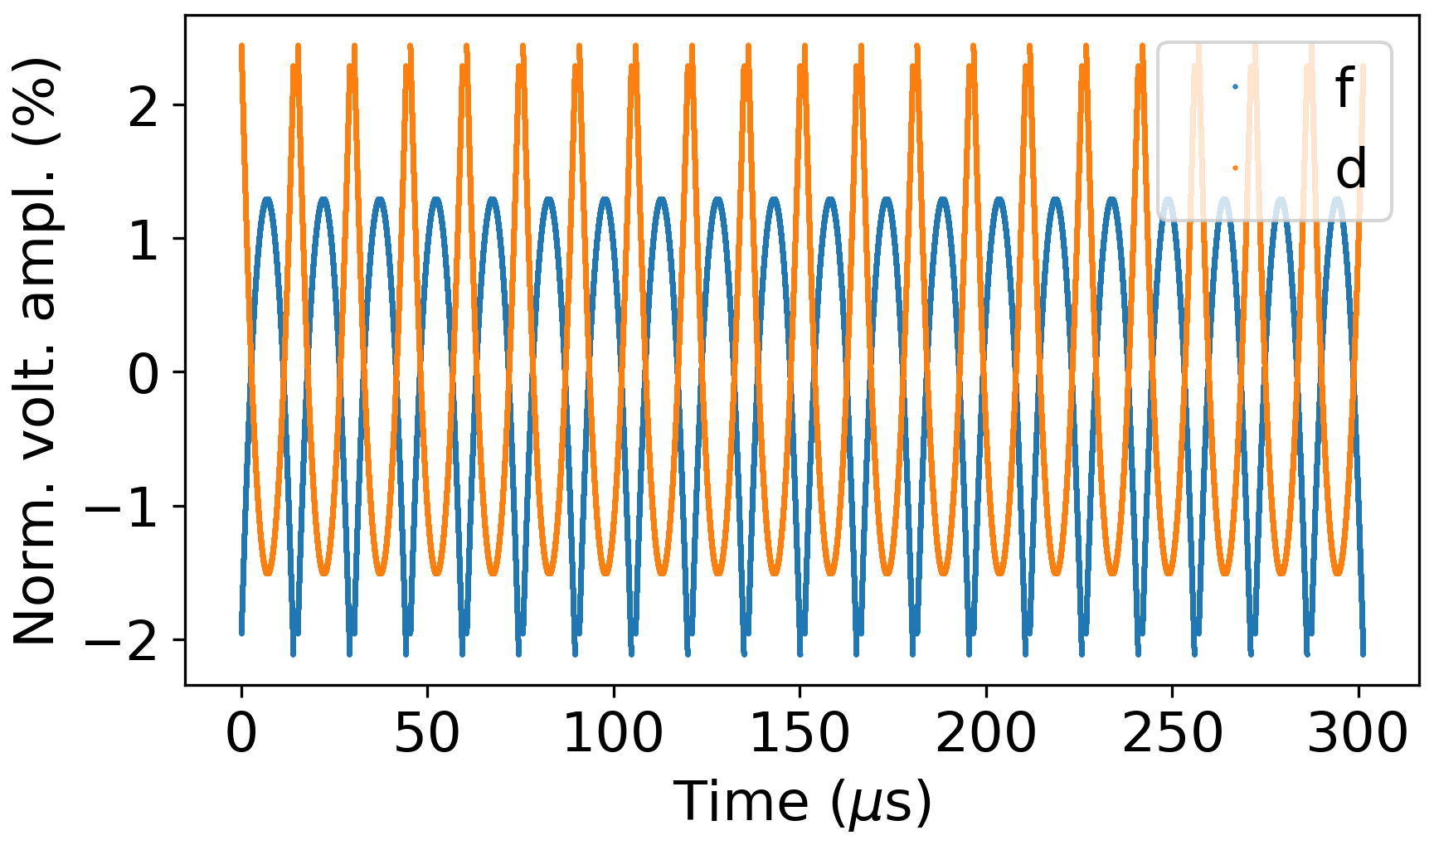
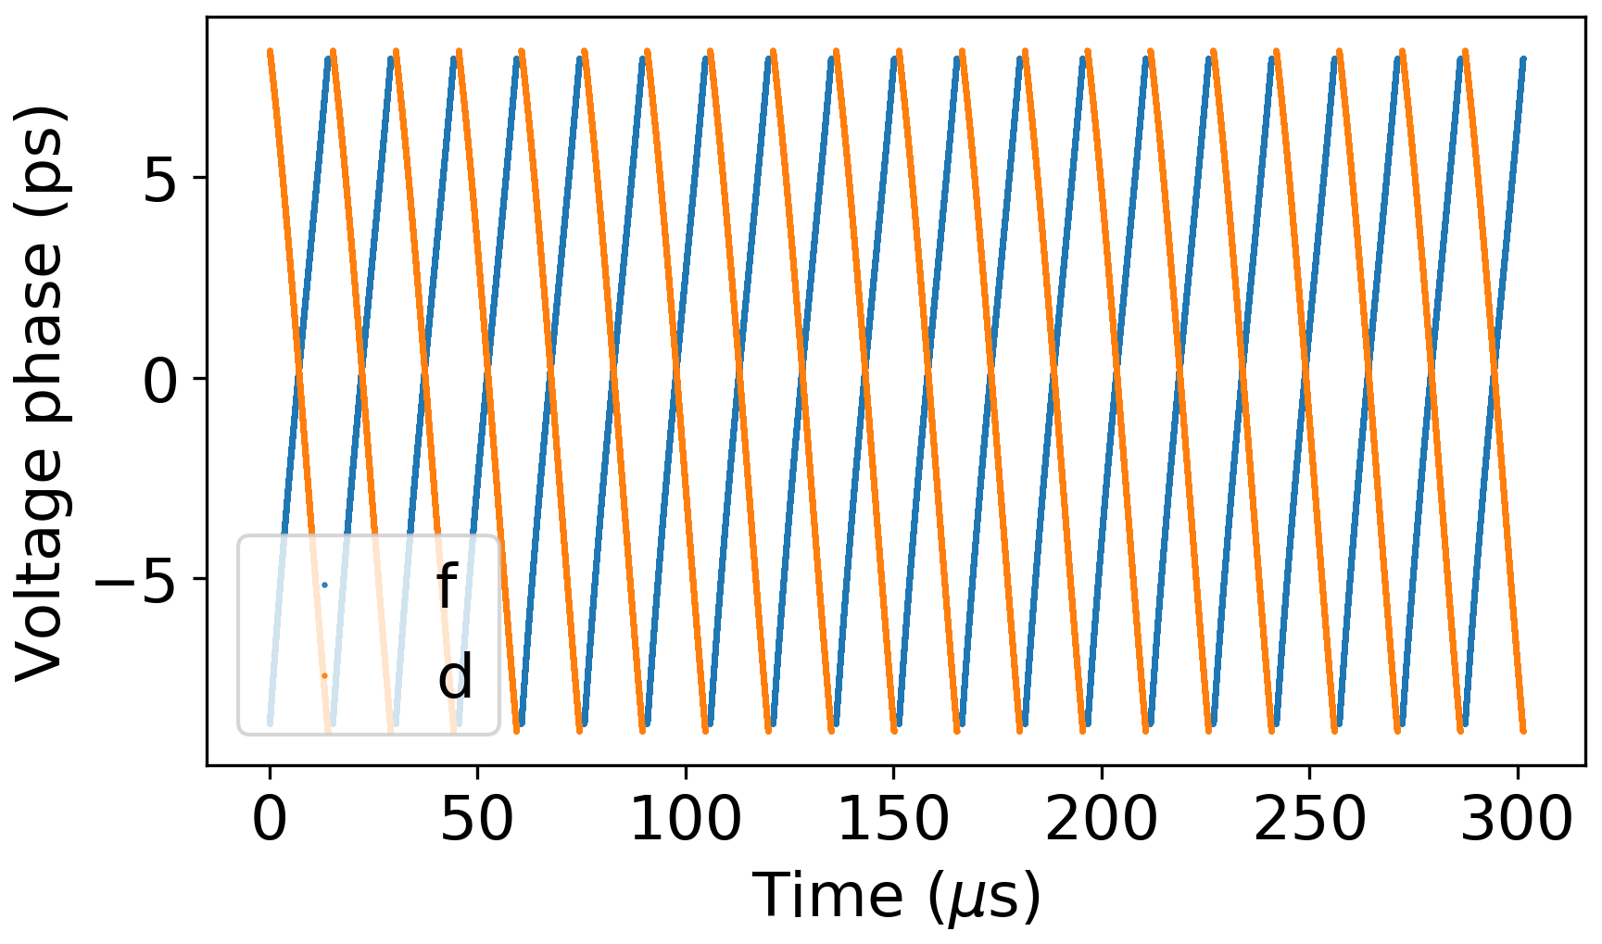
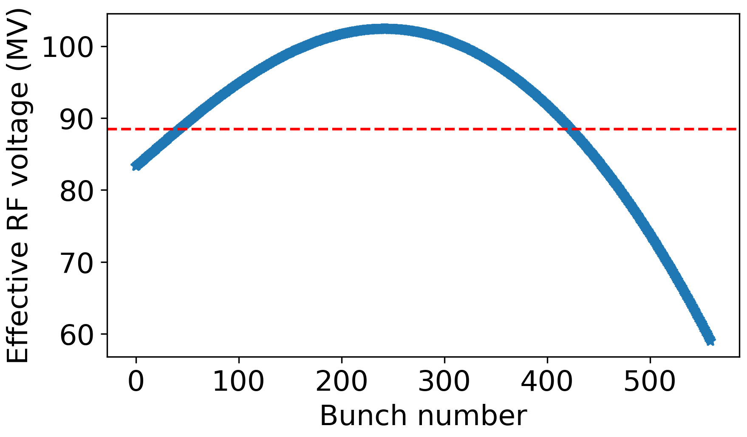
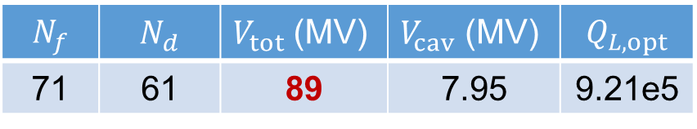
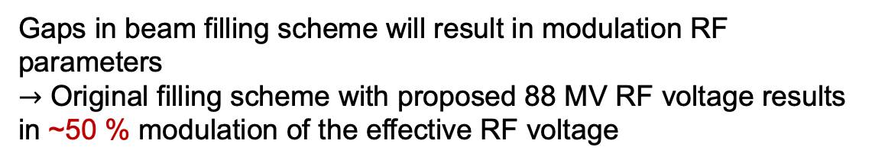
Transient beam loading with RPO
Voltage amplitude and phase transients from small-signal model (F. Pedersen, 1992)
$$N_{f}$$ | $$N_{d}$$ | $V_{tot}$(MV) | $V_{cav}$ (MV) | $$Q_{L,opt}$$
71 | 61 | 89 | 7.95 | 9.21e5
Gaps in beam filling scheme will result in modulation RF parameters
$→$ Original filling scheme with proposed 88 MV RF voltage results in ~50 % modulation of the effective RF voltage

Slide 9
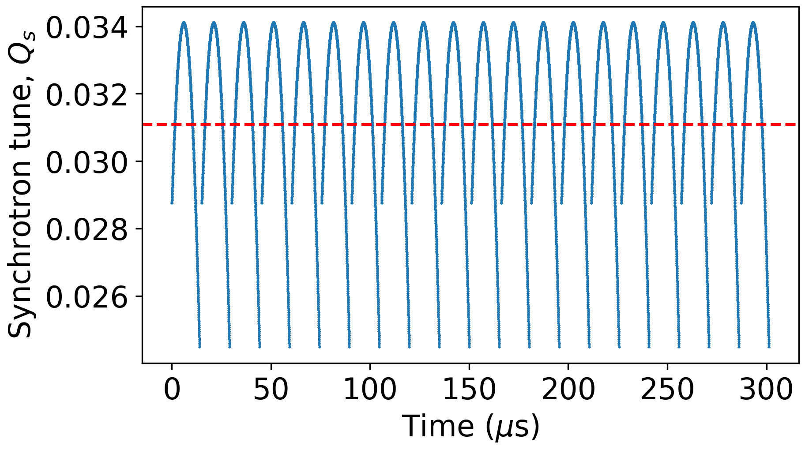
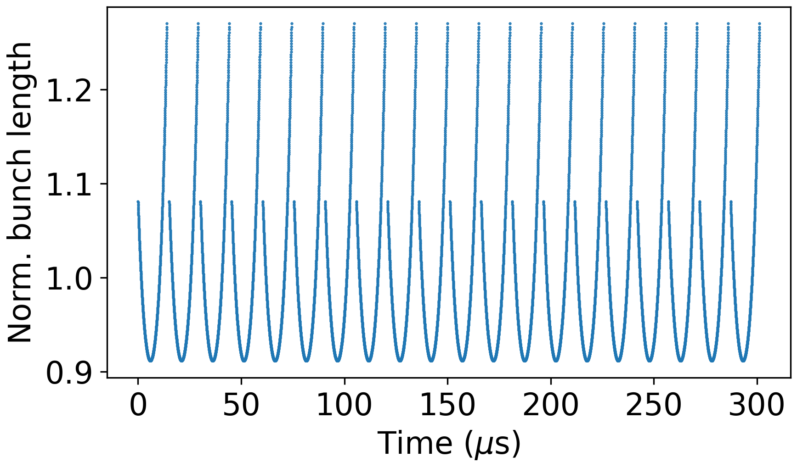
Bunch-by-bunch spread of beam parameters
Peak-to-peak variation -21/+10 %
Peak-to-peak variation -9/+27 %
Large synchrotron tune and bunch length spread can significantly degrade beam stability (e.g., due to X-Z instability, K. Ohmi, 2016)

Slide 10
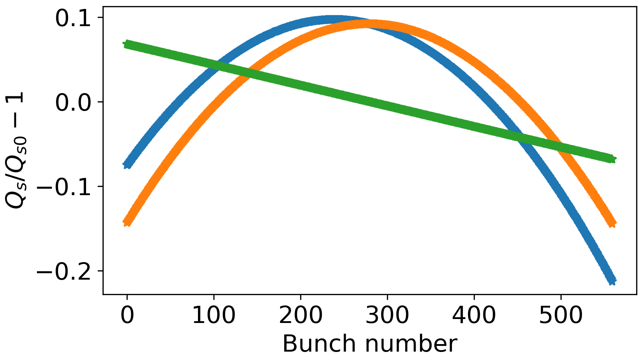
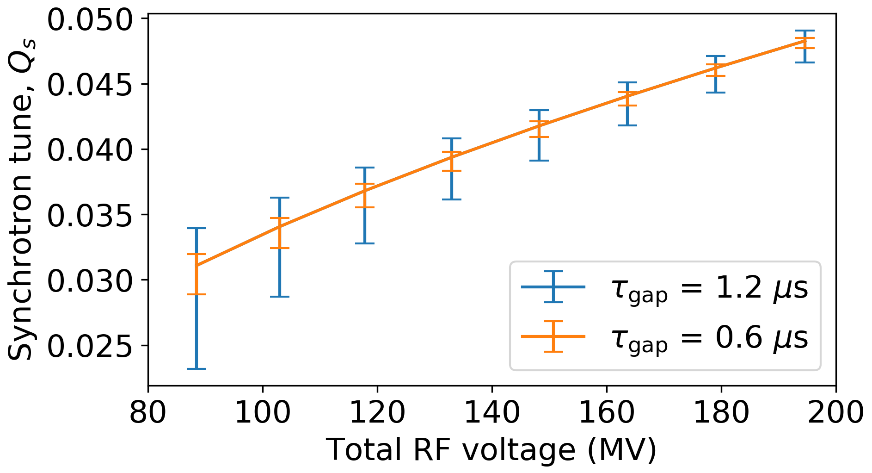
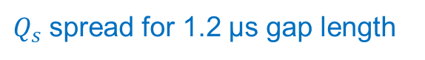
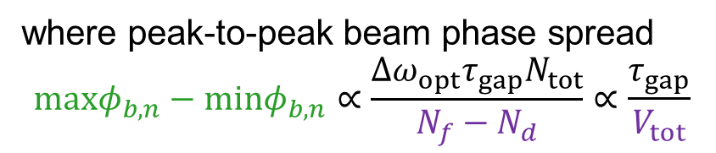
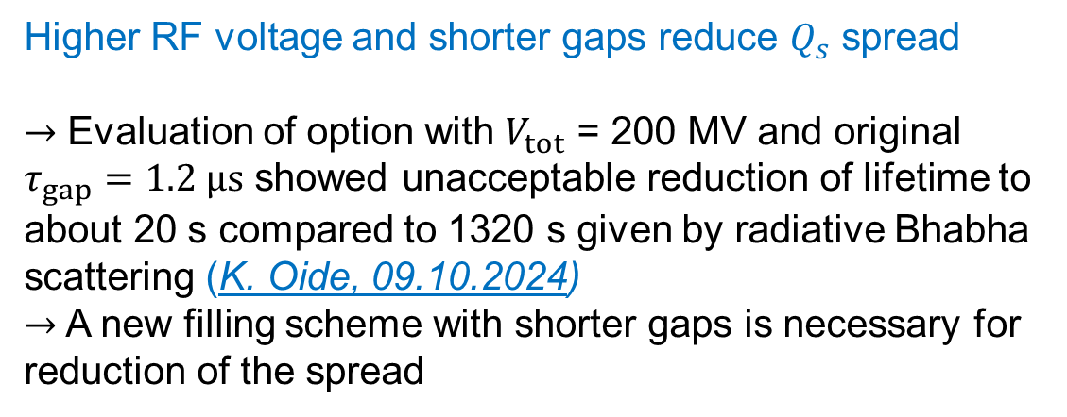
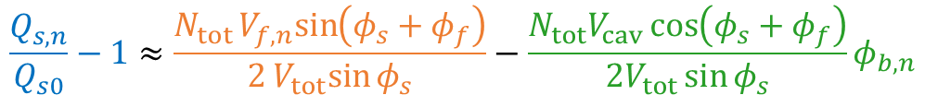

Possible mitigations
Relative contributions to $Q_{s}$ spread
Synchrotron tune spread according small-signal model
$$\frac{Q_{s,n}}{Q_{s0}}−1≈\frac{N_{tot}V_{f,n}sin\left(φ_{s}+φ_{f}\right)}{2V_{tot}sin{φ_{s}}}−\frac{N_{tot}V_{cav}\cos\left(φ_{s}+φ_{f}\right)}{2V_{tot}\sin{φ_{s}}}φ_{b,n}$$
where peak-to-peak beam phase spread
$$maxφ_{b,n}−minφ_{b,n}∝\frac{Δω_{opt}τ_{gap}N_{tot}}{N_{f}−N_{d}}∝\frac{τ_{gap}}{V_{tot}}$$
Higher RF voltage and shorter gaps reduce $Q_{s}$ spread
$→$ Evaluation of option with $V_{tot}$ = 200 MV and original $τ_{gap}=1.2 μs$ showed unacceptable reduction of lifetime to about 20 s compared to 1320 s given by radiative Bhabha scattering (K. Oide, 09.10.2024)
$→$ A new filling scheme with shorter gaps is necessary for reduction of the spread
$Q_{s}$ spread for 1.2 µs gap length
30%
5%

Slide 11
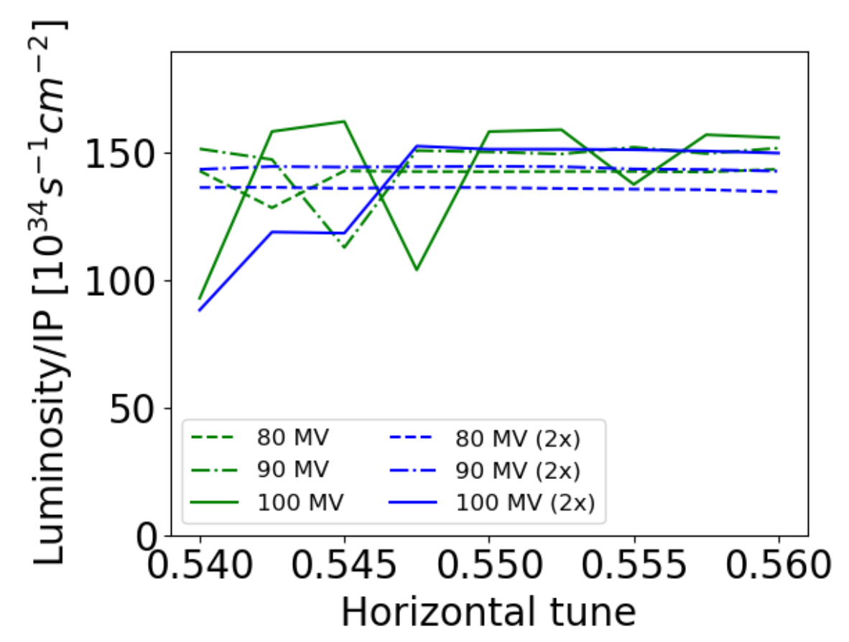
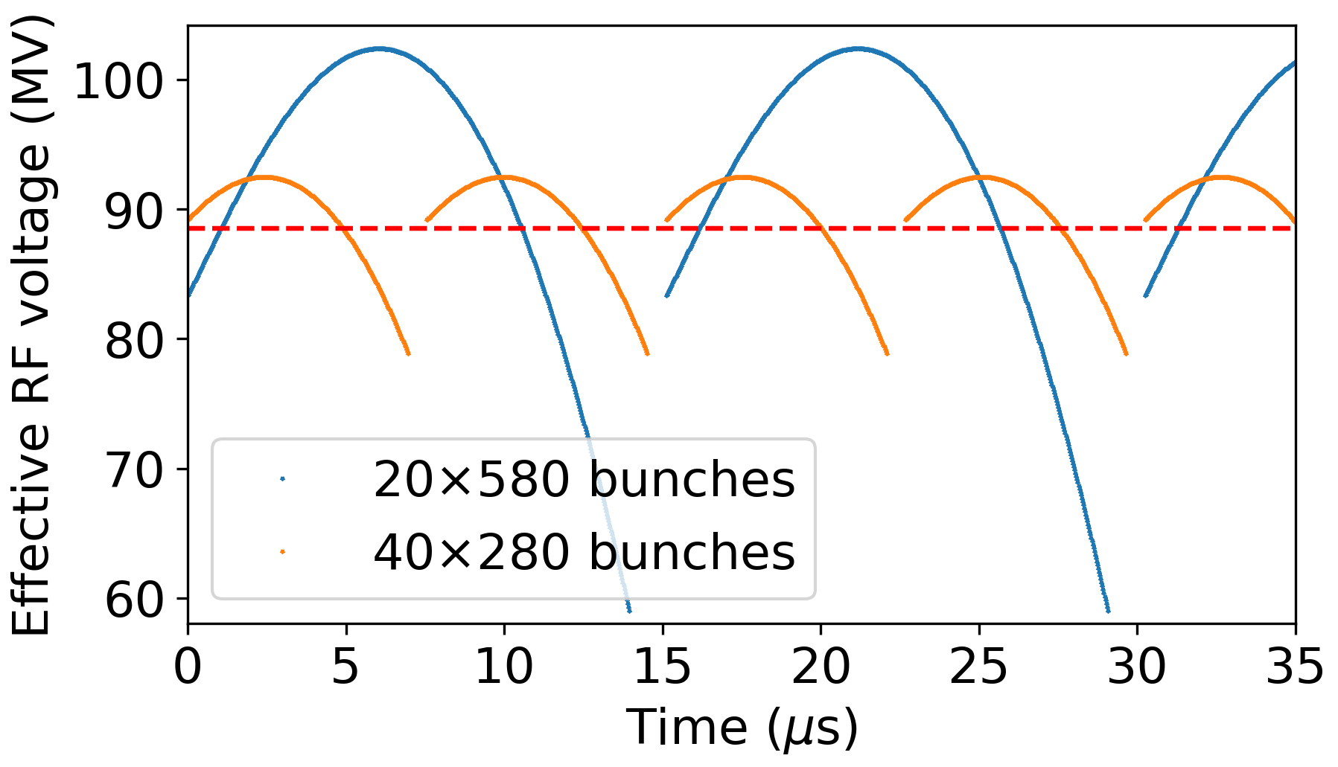
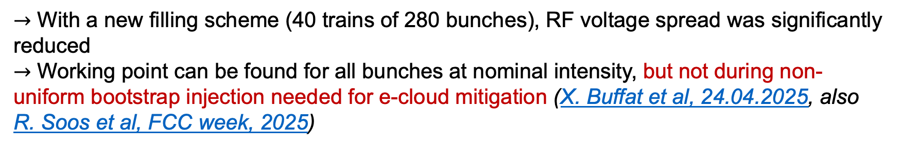
Results for smaller gaps between trains
Injection and extraction systems were adapted to decrease the rise time below 600-ns (G. Favia, FCC week, 2025)
FCC Feasibility study final report, 2025
$→$ With a new filling scheme (40 trains of 280 bunches), RF voltage spread was significantly reduced
$→$ Working point can be found for all bunches at nominal intensity, but not during non-uniform bootstrap injection needed for e-cloud mitigation (X. Buffat et al, 24.04.2025, also R. Soos et al, FCC week, 2025)

Slide 12
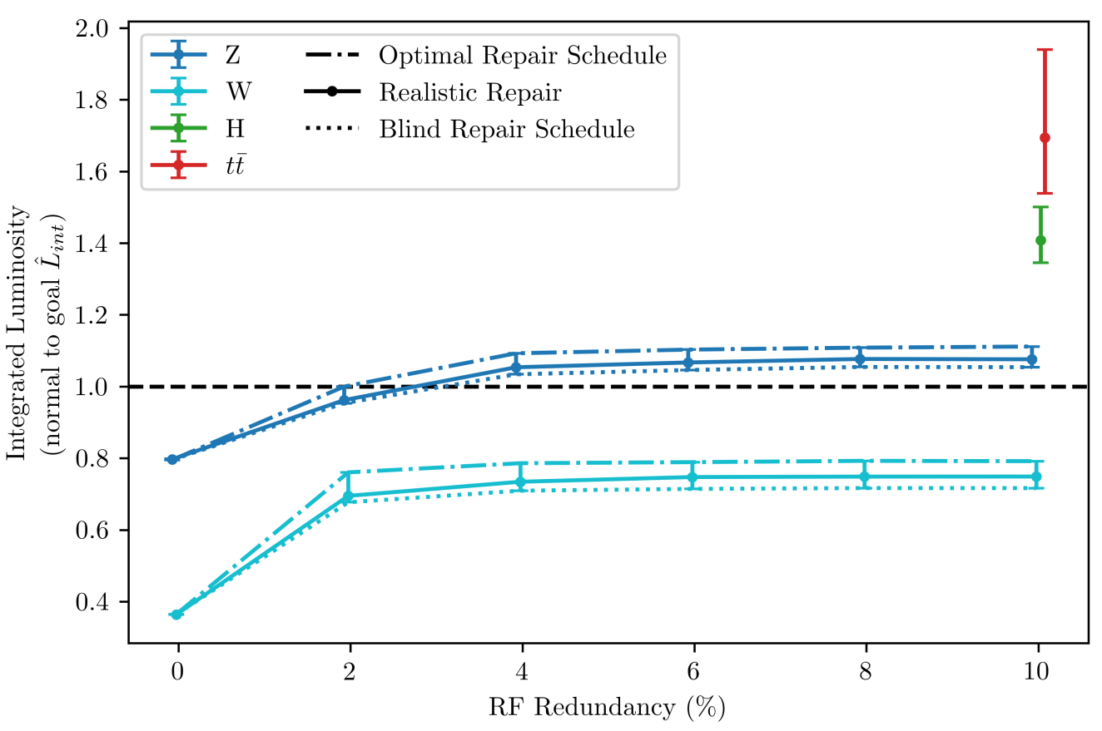
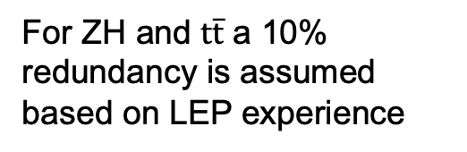
Possible scenarios of coupled bunch instabilities
Integrated luminosity vs RF system redundancy scaled from LHC data
Standard mode – all RF lines (cavities, LLRF, HLRF) are ON
Degraded mode – trip of one or more RF lines
Reaching integrated luminosity goals requires at least 3-4% redundancy of the RF system (preserve beam with up to 5 RF lines down)
For ZH and $t\overline{t}$ a 10% redundancy is assumed based on LEP experience
J. Heron, FCC Week, 2024

Slide 13
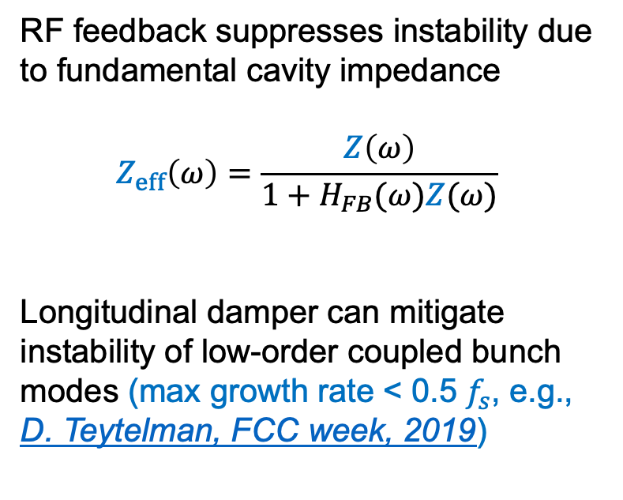
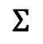
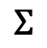
Mitigation measures
Simplified block diagram of FCC RF system similar to LHC (P. Baudrenghien et al, 2006)
RF feedback suppresses instability due to fundamental cavity impedance
$$Z_{eff}\left(ω\right)=\frac{Z\left(ω\right)}{1+H_{FB}(ω)Z(ω)}$$
Longitudinal damper can mitigate instability of low-order coupled bunch modes (max growth rate < 0.5 $f_{s}$, e.g., D. Teytelman, FCC week, 2019)
Tuner
Circulator
Forward wave
Generator
RF cavity
Reflected wave
Load
Delay
Cavity voltage
RF feedback
–
Beam
$$Σ$$
Error signal
+
Reference signal
+
$$Σ$$
+
Longitudinal damper
Phase pickup

Slide 14
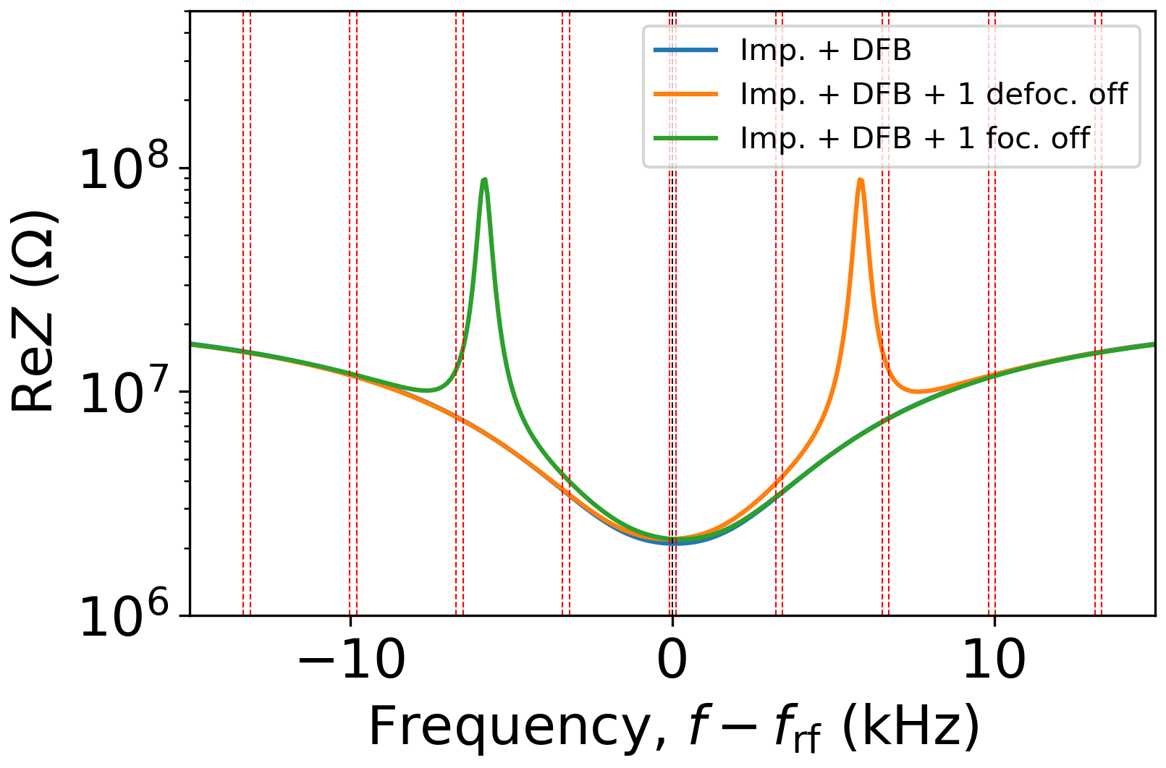
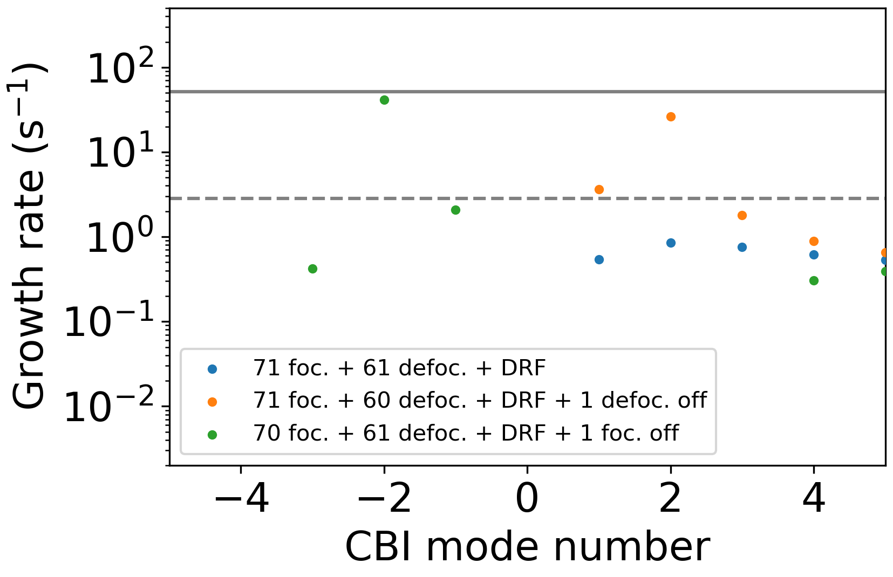
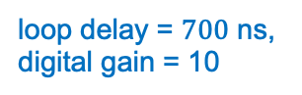
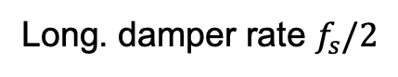
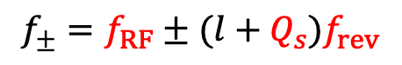
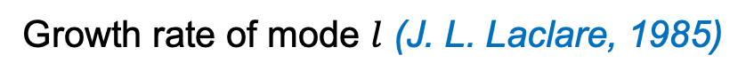
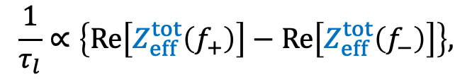
Analytical results for dipole mode
Growth rate of mode $l$ (J. L. Laclare, 1985)
$$\frac{1}{τ_{l}}∝\left\{Re\left[Z_{eff}^{tot}\left(f_{+}\right)\right]−Re\left[Z_{eff}^{tot}\left(f_{−}\right)\right]\right\},$$
$$f_{±}=f_{RF}±(l+Q_{s})f_{rev}$$
Total effective impedance with direct RF feedback (DFB)
Instability growth rates
loop delay = $700$ ns, digital gain = 10
Long. damper rate $f_{s}/2$
SR damping rate
LCBI can be suppressed with DFB in standard mode
Longitudinal damper should be sufficient to damp instability in degraded mode with one RF line being down

Slide 15
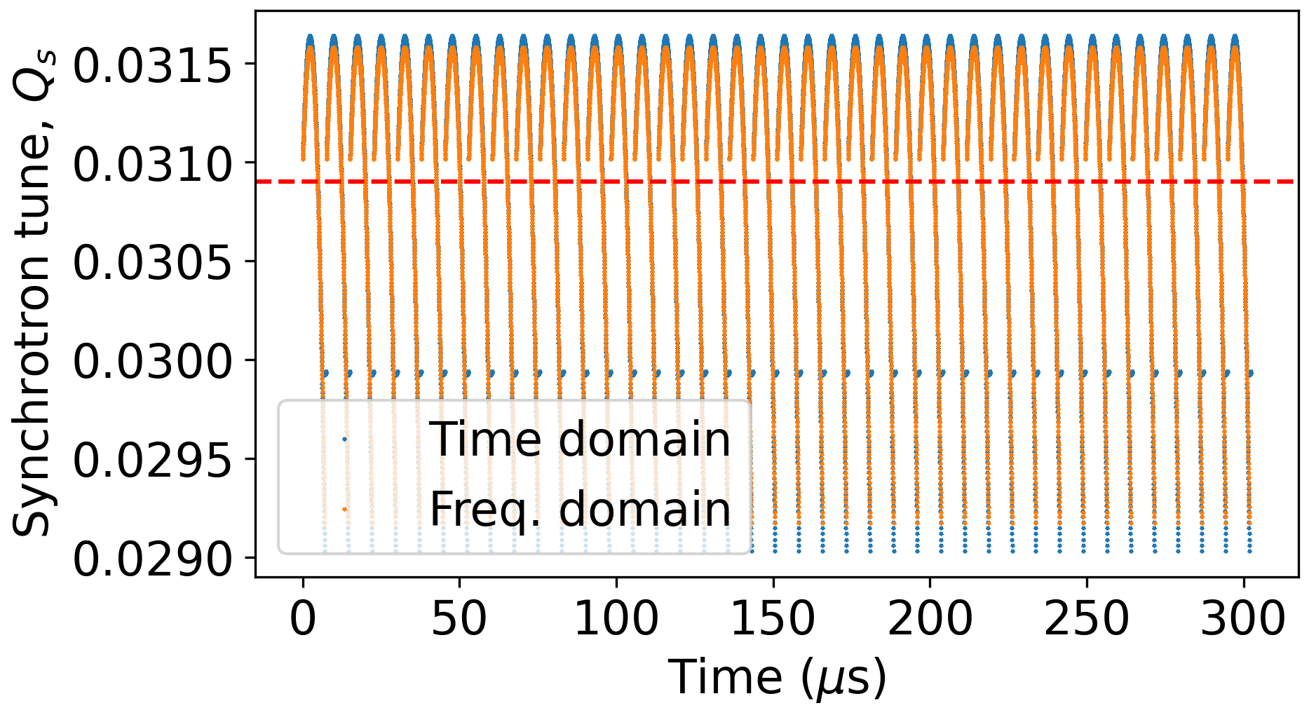
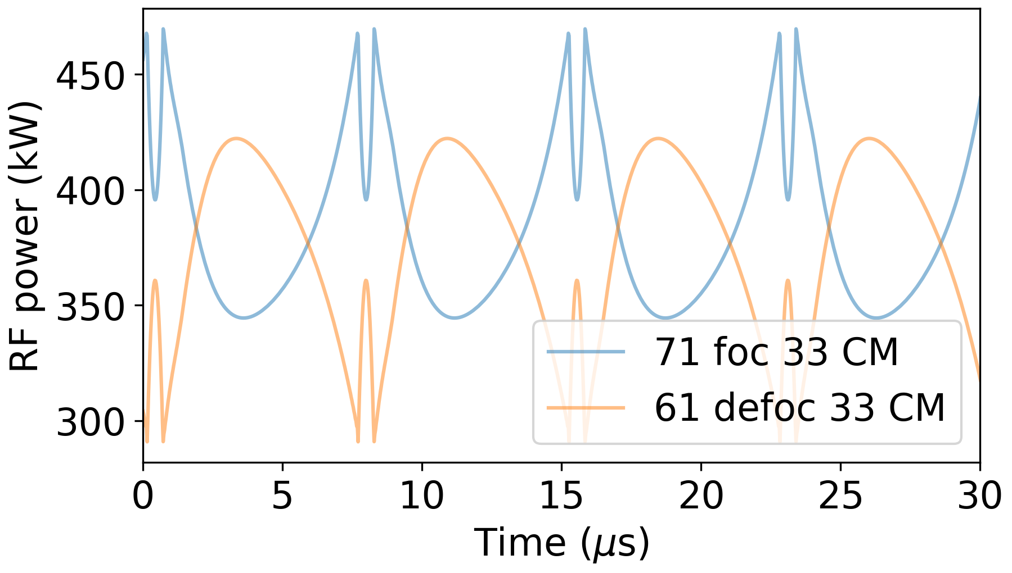
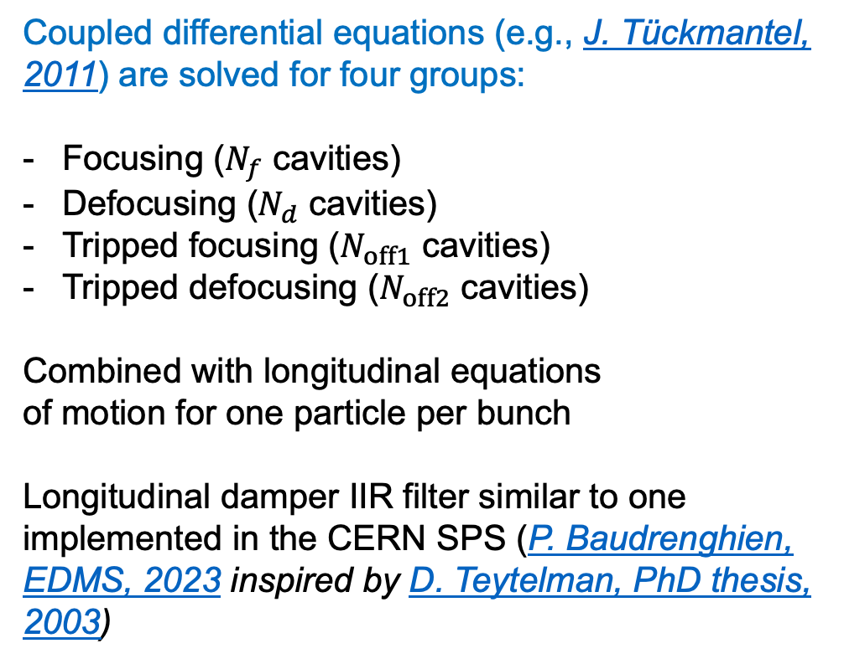
Dynamic beam-cavity interaction model
Synchrotron frequency spread
Coupled differential equations (e.g., J. Tückmantel, 2011) are solved for four groups:
Focusing ($N_{f}$ cavities)
Defocusing ($N_{d}$ cavities)
Tripped focusing ($N_{off1}$ cavities)
Tripped defocusing ($N_{off2}$ cavities)
Combined with longitudinal equations of motion for one particle per bunch
Longitudinal damper IIR filter similar to one implemented in the CERN SPS (P. Baudrenghien, EDMS, 2023 inspired by D. Teytelman, PhD thesis, 2003)
RF power transients (1/10 of ring)

Slide 16
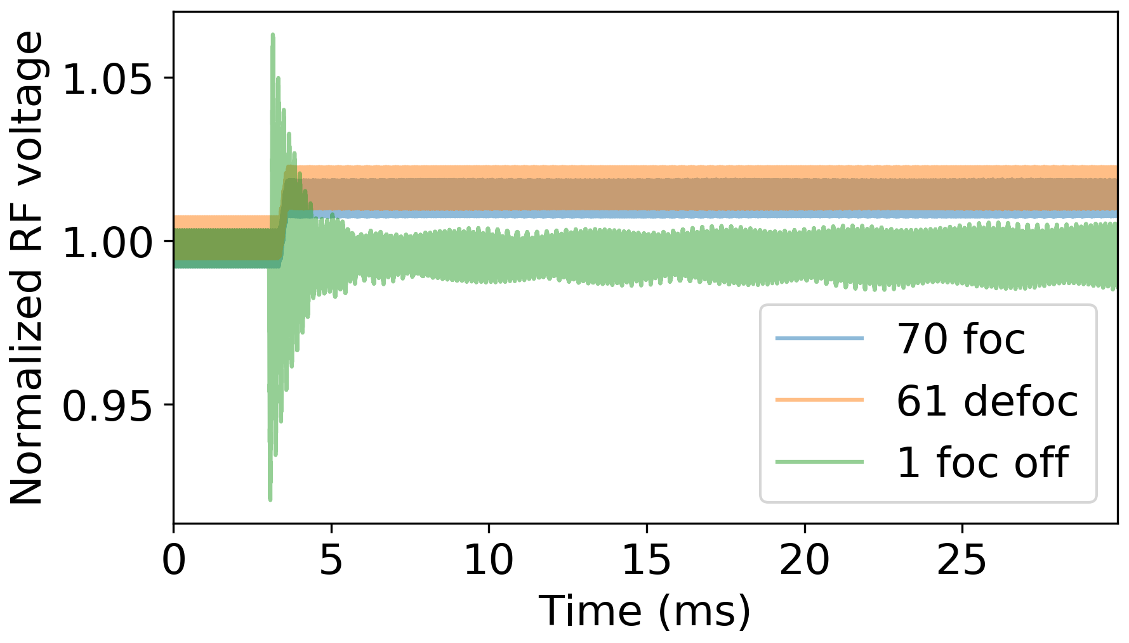



Trip of focusing cavity: first 100 turns
Reaction time
Controlled voltage increase
Trip
Short RF voltage transients ~6%
Fast adjustment of reference voltage is required to limit the initial bunch oscillation amplitude <10% of rms bunch length
$σ_{z}$ ~ 48 ps

Slide 17




Trip of focusing cavity: longer tracking
Short RF voltage transients ~6%
Fast adjustment of reference voltage is required to limit the initial bunch oscillation amplitude <10% of rms bunch length
Without longitudinal damper beam becomes unstable
$σ_{z}$ ~ 48 ps

Slide 18





Trip of focusing cavity: longitudinal damper ON
$σ_{z}$ ~ 48 ps
Longitudinal damper preserves beam stability
Ramping up the gain 0.1$→$ 0.5 within ~250 turns is required to keep RF power transients below ~500 kW
RF line recovery scenario needs to be analyzed

Slide 19
Summary
The FCC-ee baseline RF system allows switching between for Z, WW, and ZH operating points without hardware modifications.
This requires Reverse Phase Operation (RPO) at Z operating point and common RF system for two beams at ZH operating point
Flexibility of operation sequence poses additional challenges:
Strong transient beam loading leads to significant modulation of RF and beam parameters.
Required 4% redundancy to achieve integrated luminosity goals cannot be demonstrated with dynamic beam-cavity interaction model. RF power margins could be sufficient to preserve the beam only in the case of a single RF line trip.
Thank you for your attention!

Slide 20
Backup slides

Slide 21




Trip of focusing and defocusing cavities
Reaction time
Controlled voltage increase
Trip
Short RF voltage transients ~6%
Peak power of other cavities is modulated at synchrotron frequency (avg. <45%, peak <80%)
Initial bunch oscillation amplitude is <8% of rms bunch length
$→$ Not enough power margin to handle simultaneous trip of two cavities
$σ_{z}$ ~ 48 ps

Slide 22
Example for Z mode
Longitudinal damper OFF
Longitudinal damper ON, gain ramp 0.1-> 0.5 (within ~250 turns)

Slide 23


Example for Z mode
Longitudinal damper OFF
Longitudinal damper ON, gain ramp 0.1-> 0.5 (within ~250 turns)

Slide 24




Higher total RF voltage
Reaction time
Controlled voltage increase
Trip
$σ_{z}$ ~ 48 ps
Moving from 89 to 195 MV reduces RF power transient:
$→$ Is there a room for this in LCC optics?
$→$ Can we profit from relaxed bunch charge for non-uniform filling schemes?

Slide 25

Instability growth rates
132 2-cell cavities with RPO
SR limit
Calculations for loop delay of $700$ ns, DFB gain 10, OTFB gain 20:
$→$ LCBI can be suppressed already with DFB, while OTFB gives additional stability margin

Slide 26



HOM-driven coupled-bunch instabilities
Longitudinal plane:
No trapped HOMs
$→$ impedance is well below the SR threshold
Updated 2-cell design with suppressed $(R/Q)$ of 0-mode at $f_{r0}=\text{39}\text{7}\text{.}\text{61}$ MHz by 2 orders of magnitude (S. Gorgi Zadeh, 15.08.2024)
$→$ Only twice below SR damping limit for $Q_{L}=Q_{L,opt}$ (might be larger due to limited bandwidth of circulator)
$→$ We gain a factor of 20 with 10 kHz frequency spread from cavity to cavity
Transverse plane:
Instabilities growth rates (min. rise time > 100 turns) are within capabilities of transverse feedback system (W. Hofle, 2024)
SR damping
SR damping

Slide 27



Simplified beam-cavity interaction model
Coupled differential equations are solved for four groups:
Focusing ($N_{f}$ cavities)
Defocusing ($N_{d}$ cavities)
Tripped focusing ($N_{off1}$ cavities)
Tripped defocusing ($N_{off2}$ cavities)
Combined with longitudinal equations of motion for one particle per bunch
Longitudinal damper is not implemented yet
Tuner
Circulator
Forward wave
Generator
RF cavity
Reflected wave
Load
Delay
Cavity voltage
Direct RF feedback
–
Beam
$$Σ$$
Error signal
+
Reference signal
+
$$Σ$$
+
Longitudinal damper
Phase pickup

Slide 28


Alternative filling schemes
Hybrid filling schemes with 5-ns spacing micro-trains can suppress e-cloud limitations (L. Sabato, presentation yesterday)
$→$ Negligible impact on the RF voltage spread (15.3 % $→$ 16.8 %)

Slide 29







RF baseline evolution for collider
FCC Conceptual design report (2018)
F. Peauger, FCC Week 2022 & FCC FS MTR (2024)
FCC FS Final Report (2025)
Operational margins
Less HOM power for WW with 2-cell cavities
Same RF for WW & ZH
Same RF for Z, WW & ZH
One power source per cavity
6-cell for $t\overline{t}$ for cost reduction
Z
×104
×112
×264
WW
×104
×264
×264
ZH
×272
×264
×264
Common RF for 2 beams
Common RF for 2 beams
$$t\overline{t}$$
×272
×264
×264
+
Common RF for 2 beams
+
+
×372
×488
×408
Reverse Phase Operation (RPO) mode for Z is required to unify Z-WW-ZH RF system

Slide 30



Trip of focusing cavity
Short RF voltage transients ~6%
Peak power of other cavities is modulated at synchrotron frequency (avg. <15%, peak <32%)
Initial bunch oscillation amplitude is <10% of rms bunch length
Beam is unstable without longitudinal damper due to uncompensated impedance
$σ_{z}$ ~ 48 ps

Slide 31



Trip of defocusing cavity
$σ_{z}$ ~ 48 ps
Similar results to the case of focusing cavity trip
Simultaneous trip of two cavities of any type leads to significant RF power overshoot

Slide 32



Trip of 3 single-cell cavities (4% redundancy)
$σ_{z}$ ~ 48 ps
Smaller relative transient compared RPO scheme
Absolute peak power modulation exceeds 1 MW level

Slide 33













Reverse phase operation
Reverse phase operation (RPO) mode allows for increasing RF cavity voltage having optimal static beam loading compensation (Y. Morita et al., SRF, 2009)
Experimentally verified with high beam loading in KEKB (Y. Morita et al., IPAC, 2010)
Baseline solution for EIC ESR (e.g., J. Guo et al., IPAC, 2022)
Phasors
RF waves
$$N_{f}+N_{d}=N_{tot}$$
$$N_{f}V_{cav,RPO}$$
$$φ_{f}$$
$$φ_{s}^{∗}+π/2$$
$$N_{f}V_{cav,RPO}$$
$$N_{tot}V_{cav,NPO}$$
$$φ_{s}$$
$$N_{d}V_{cav,RPO}$$
$$N_{d}V_{cav,RPO}$$
$$φ_{d}$$
$$N_{tot}V_{cav,NPO}$$
*Electron convention for synchronous phase: $φ_{s,proton}=\frac{π}{2}+φ_{s,electron}$

Slide 34

RF baseline evolution
Z
WW
ZH
$$t\overline{t}$$
FCC Conceptual design report (2018)
Separate RF systems
Common RF system
F. Peauger, FCC Week 2022 &
FCC FS Mid-Term Report (2024)
Separate RF systems
Common RF system
FCC FS Final Report (2025)
Separate RF systems
Common RF system

Slide 35

SPS Longitudinal damper model
RF seminar of I. Stachon

Slide 36

SPS Longitudinal damper model
RF seminar of I. Stachon
Details are in the EDMS document prepared by P. Baudrenghien

Slide 37









Higher-order mode power
$$P_{HOM}=I_{b,DC}^{2}\sum_{k=−∞}^{∞}{Re\left[Z\left(kf_{rev}\right)\right]{\left|I_{k}\right|}^{2}}$$
HOM power equation
Option | $V_{tot}$(MV) | $σ_{z,BS}$ (mm)
1 | 103.00 | 14.6
2 | 117.86 | 13.7
In absence of resonant modes $→$
$P_{HOM}=k_{∥,HOM}I_{b,DC}Q_{b}$
Option 1: $P_{HOM}≈57.2 kW$
K. Oide, 06.11.2024
3.7 kW
3.7 kW
4.5 kW
4.9 kW
4.2 kW
1.9 kW
5.3 kW
6.1 kW
5.3 kW
5.8 kW
5.5 kW
5.7 kW
Tapers contribution to the HOM power
2 coaxial HOM couplers
Option 2: $P_{HOM}≈65.1 kW$
4.2 kW
4.3 kW
5.1 kW
5.5 kW
4.8 kW
2.3 kW
6.4 kW
6.8 kW
5.9 kW
6.5 kW
6.1 kW
6.4 kW
Unavoidable 15 kW increase in HOM power compared to single-cell design for option 1 and potentially up to 10 kW deposited in resonance mode (S. Gorgi Zadeh, 23.01.2024)
$→$ Verification of possible reduction of the tapering angle at the extremities of the cavity string is ongoing (K. Canderan, 29.10.2024)

Slide 38


Baseline collider RF system configuration
MTR recommendation:
Study options to avoid the 1-cell/2-cell RF cavity reconfiguration between Z and H/WW running to simplify the SRF system implementation and improve flexibility in the physics programme.
Proposed solution:
Installation of 2-cell cavities with individual RF power sources (~0.5 MW level) from the beginning
Reverse phase operation (RPO) mode for Z, normal mode for W and H (combined RF system for 2 beams)
$→$ Applicability of RPO for FCC-ee needs to be confirmed
66
Extra year of operation?
Courtesy of O. Brunner

Slide 39



Beam loading model: main equation
$$I_{g}=\frac{V}{2(R/Q)}\left(\frac{1}{Q_{0}}+\frac{1}{Q_{ext}}−2i\frac{Δω}{ω_{rf}}\right)+\frac{I_{b,rf}}{2}$$
Generator current
$$P_{g}=\frac{1}{2}Z_{ext}{\left|I_{g}\right|}^{2}=\frac{1}{2}{(R/Q)Q}_{ext}{\left|I_{g}\right|}^{2}$$
Generator power
Fixed parameters are $V$, $(R/Q)$, $Q_{0}$, $ω_{rf}$, $I_{b,rf}$, while $V$, $Δω$, and $Q_{ext}$ can be adjusted
See, e.g., J. Tückmantel, CERN Report No. CERN-ATS-Note-2011- 002 TECH, 2011

Slide 40






Derivations for arbitrary cavity phase (1/2)
$$I_{g}=\frac{V}{2(R/Q)}\left(\frac{1}{Q_{0}}+\frac{1}{Q_{ext}}−2i\frac{Δω}{ω_{rf}}\right)+\frac{I_{b,rf}}{2}$$
Generator current
0
Complex quantities: $I_{g}$, $V$, and $I_{b,rf}$ $→$
$I_{g}=\left|I_{g}\right|e^{iφ_{L}}$, $V=\left|V_{cav}\right|e^{iφ_{c}}$, $I_{b,rf}=\left|F_{b}\right|I_{b,dc}e^{−iφ_{s}}$
$$\left|I_{g}\right|e^{iφ_{L}}=\frac{\left|V_{cav}\right|e^{iφ_{c}}}{2(R/Q)}\left(\frac{1}{Q_{ext}}−2i\frac{Δω}{ω_{rf}}\right)+\frac{\left|F_{b}\right|I_{b,dc}e^{−iφ_{s}}}{2}$$
$${×e}^{−iφ_{c}}$$
$$\left|I_{g}\right|e^{iφ_{L}−iφ_{c}}=\frac{\left|V_{cav}\right|}{2(R/Q)}\left(\frac{1}{Q_{ext}}−2i\frac{Δω}{ω_{rf}}\right)+\frac{\left|F_{b}\right|I_{b,dc}e^{−iφ_{s}−iφ_{c}}}{2}$$
Then splitting in real and imaginary parts:

Slide 41





Derivations for arbitrary cavity phase (2/2)
$$\left|I_{g}\right|e^{iφ_{L}−iφ_{c}}=\frac{\left|V_{cav}\right|}{2(R/Q)Q_{ext}}+\frac{\left|F_{b}\right|I_{b,dc}\cos\left(φ_{s}+φ_{c}\right)}{2}−i\left[\frac{\left|V_{cav}\right|}{\left(R/Q\right)}\frac{Δω}{ω_{rf}}+\frac{\left|F_{b}\right|I_{b,dc}\sin\left(φ_{s}+φ_{c}\right)}{2}\right]$$
$$P_{g}=\frac{1}{2}{(R/Q)Q}_{ext}{\left|I_{g}\right|}^{2}=\frac{1}{2}{(R/Q)Q}_{ext}{\left[\frac{\left|V_{cav}\right|}{2\left(R/Q\right)Q_{ext}}+\frac{\left|F_{b}\right|I_{b,dc}\cos\left(φ_{s}+φ_{c}\right)}{2}\right]}^{2}$$
$$+\frac{1}{2}{(R/Q)Q}_{ext}{\left[\frac{\left|V_{cav}\right|}{\left(R/Q\right)}\frac{Δω}{ω_{rf}}+\frac{\left|F_{b}\right|I_{b,dc}\sin\left(φ_{s}+φ_{c}\right)}{2}\right]}^{2}$$
Minimized for $Q_{ext,opt}=\frac{\left|V_{cav}\right|}{\left|F_{b}\right|\left(R/Q\right)I_{b,dc}\cos\left(φ_{s}+φ_{c}\right)}$
= 0 for $Δω_{opt}=−\frac{ω_{rf}\left(R/Q\right){\left|F_{b}\right|I}_{b,dc}\sin\left(φ_{s}+φ_{c}\right)}{2\left|V_{cav}\right|}$
Setting $φ_{c}=0$ recovers classical equations for optimal parameters
Adjusting $φ_{c}$, $Q_{ext,opt}$ can be modified to meet certain constraints
$$P_{g,opt}=\frac{\left|V_{cav}\right|{\left|F_{b}\right|I}_{b,dc}\cos\left(φ_{s}+φ_{c}\right)}{2}$$
The minimum power

Slide 42









RF power requirements
Constraints:
- The same $Q_{ext,opt}$ for all cavities to avoid a movable fundamental power coupler design
- The same $P_{g,opt}$ to have the identical power sources and uniform power distribution (role of variations is under study)
$$Q_{ext,opt}=\frac{\left|V_{cav}\right|}{\left|F_{b}\right|\left(R/Q\right)I_{b,dc}\cos\left(φ_{s}+φ_{c}\right)}$$
$$P_{g,opt}=\frac{\left|V_{cav}\right|\left|F_{b}\right|I_{b,dc}\cos\left(φ_{s}+φ_{c}\right)}{2}$$
$→$ Cavity voltage must be the same for all cavities: $\cos\left(φ_{s}+φ_{foc}\right)$= $\cos\left(φ_{s}+φ_{defoc}\right)$ $→$ $φ_{foc}=−2φ_{s}−φ_{defoc}$
Starting with energy gain per turn
$$×\frac{{\left|F_{b}\right|I}_{b,dc}}{2}$$
$$N_{foc}\left|V_{cav}\right|\cos\left(φ_{s}+φ_{foc}\right)+N_{defoc}\left|V_{cav}\right|\cos\left(φ_{s}+φ_{defoc}\right)=V_{tot}\cos{φ_{s}}$$
$$N_{foc}\frac{{\left|V_{cav}\right|\left|F_{b}\right|I}_{b,dc}cos\left(φ_{s}+φ_{foc}\right)}{2}+N_{defoc}\frac{\left|V_{cav}\right|{\left|F_{b}\right|I}_{b,dc}\cos\left(φ_{s}+φ_{defoc}\right)}{2}=\frac{{\left|F_{b}\right|I}_{b,dc}}{2}V_{tot}\cos{φ_{s}}$$
$$\cos{φ_{s}}=\frac{U_{0}}{V_{tot}}$$
$$\left|F_{b}\right|≈2$$
$$P_{g,foc}=P_{g,defoc}=P_{g,opt}$$
$$N_{foc}P_{g,foc}+N_{defoc}P_{g,defoc}=I_{b,dc}U_{0}=P_{SR}$$
$$N_{foc}+N_{defoc}=N_{tot}$$
$$P_{g,opt}=\frac{P_{SR}}{N_{tot}}$$
$→$ No RF power overshoot is needed for RPO if optimal detuning and optimal quality factor are used

Slide 43






Reverse phasing mode equations
Preservation of energy gain
$$N_{foc}\left|V_{cav}\right|\cos\left(φ_{s}+φ_{foc}\right)+N_{defoc}\left|V_{cav}\right|\cos\left(φ_{s}+φ_{defoc}\right)=V_{tot}\cos{φ_{s}}$$
Preservation of synchrotron tune
$$N_{foc}\left|V_{cav}\right|\sin\left(φ_{s}+φ_{foc}\right)+N_{defoc}\left|V_{cav}\right|\sin\left(φ_{s}+φ_{defoc}\right)=V_{tot}\sin{φ_{s}}$$
$$\left|V_{cav}\right|=\frac{V_{tot}}{N_{tot}}\sqrt{\frac{U_{0}^{2}}{V_{tot}^{2}}+\left(1−\frac{U_{0}^{2}}{V_{tot}^{2}}\right)\frac{N_{tot}^{2}}{{\left(N_{foc}−N_{defoc}\right)}^{2}}}$$
$→$ Cavity voltage
$$Δω_{opt}=−\frac{ω_{rf}\left(R/Q\right){\left|F_{b}\right|I}_{b,dc}}{2V_{cav}}\sqrt{1−\frac{U_{0}^{2}}{V_{cav}^{2}N_{tot}^{2}}}$$
Optimal detuning
See, also A. Blednykh et al, EIC-ADD-TN-33, 2022
Phases
$$φ_{foc}=−φ_{s}+\arccos\left(\frac{V_{tot}\cos{φ_{s}}}{N_{tot}V_{cav}}\right)$$
$$φ_{defoc}=−φ_{s}−\arccos\left(\frac{V_{tot}\cos{φ_{s}}}{N_{tot}V_{cav}}\right)$$
The aim is to keep $V_{cav}$, $P_{g,opt}$, and $Q_{ext,opt}$ for Z, W, and ZH modes
$→$ Cavity voltage can be change in discrete steps of $N_{foc}−N_{defoc}=2, 4,…$

Slide 44


Critical impact of spread
A coherent beam-beam instability, X-Z instability (K. Ohmi, 2016)
Threshold $∝\frac{Q_{s}}{ξ_{x}}$
Working point chosen between resonances $nQ_{x}+mQ_{s}=1$ and $nQ_{x}+(m+1)Q_{s}=1$
Higher $Q_{s}$
$→$ stronger low order resonance but more space available between them
Bunches are ~50% shorter (assuming the same $σ_{δ}$)
$→$ stronger beamstrahlung ($ξ_{y}$ increase is smaller)
$→$ stronger impact of longitudinal impedance?
M. Migliorati, 2024

Slide 45




Parameter sensitivity of RPO
Small, but visible impact of parameter spread on global parameters (e.g., $Q_{s}$)

Slide 46




Steady-state beam loading
RF power for SRF cavities with circulators is minimized for optimal parameters:
Optimal detuning
$$Δω_{opt}=−\frac{ω_{RF}\left(R/Q\right){ I}_{b,DC}\sin{φ_{s}}}{V_{cav}}$$
Optimal parameters for different scenarios
$$Q_{L,opt}=\frac{V_{cav}}{2\left(R/Q\right)I_{b,DC}\cos{φ_{s}}}$$
Optimal quality factor
Increasing $\left(R/Q\right)$ (43.8$→$90.6 Ohm) and reducing $V_{cav}$:
$→$Large range for $Q_{L,opt}$ adjustment (a factor of ~75-600) starting from $\sim 5×{10}^{3}$: possible FPC solutions under study (S. Gorgi Zadeh and E. Montesinos, CERN SRF, 2024; see also slides of F. Gerigk, FCC week 2024)
$→$ Incresed detuning enhances instability due to fundamental mode
Can the total voltage be increased for Z mode?

Slide 47








New adjustable power coupler concept
$$W_{tune}$$
$$L_{tune}$$
Two windows (LINAC4-like) are placed outside the cryomodule → integration challenge after cryostating
A more robust and easier-to-cool down window design → easier to cover all four working points
Providing ~1 MW in CW operation with variable coupling for Z, W, H, ttbar.
HOM power see: F. Peauger & I. Karpov
Prototyping starting.
t
W
This length can be increased by λ/2 (374 mm) and get similar results
Z
Z
W
$L_{tune}=450 mm$,
$W_{tune}=55 mm$,
$Q_{ext}=1.33e$4,
$E_{pk−window}=0.18 MV/m$,
$$E_{pk−air}=0.22 MV/m$$
$L_{tune}=250 mm$,
$W_{tune}=127 mm$,
$Q_{ext}=8.48e5$,
$E_{pk−window}=0.35 MV/m$,
$$E_{pk−air}=0.61 MV/m$$
$E$ normalized to 1J stored energy

